Slide 1
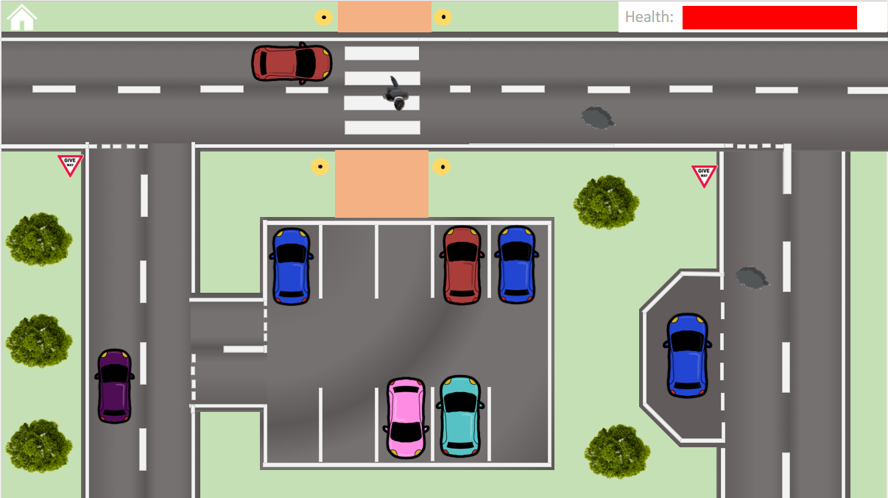
My Coursework Project
BHASVIC
Centre Number: 56120
Candidate Number: 3122
Molly Sheppard

Slide 2

Analysis

Slide 3
My Idea
My idea is a 2-dimensional parking game, which allows the user to drive, park and customise their car. My idea was influenced by games such as Parking Mania, which is also a 2D parking game. However, I would like to implement further features such as extra-mini games, car customisability and other collectibles. The game will include a menu with choosing different levels and customisability for a range of cars, as well as the main gameplay where I could experiment with extending worlds and trickier obstacles. When a car hits the pavement, runs over a pot-hole, running red lights, pedestrians etc. the car’s health will be reduced until it becomes totalled to add an element of difficulty to the game. Taken from Parking Mania, collectible coins could be around the map that offer people more reward – this can go towards different cars for customisation. Perhaps, I could consider implement extra mini-games to allow more of a reward when finishing a level or to increase the car’s health – such as car washing or parking puzzle games like Parking Jam. This would also make my game more unique compared to other common parking games such as Parking Mania. I will investigate more games similar to my idea to find elements to implement or avoid adding to my own game.
I have yet to consider the IDE I will use between C# in Unity or JAVA in Greenfoot, which would each provide differing interfaces and difficulties. However, I will investigate which would be best to create the ideal parking game by looking into tutorials for both.

Slide 4
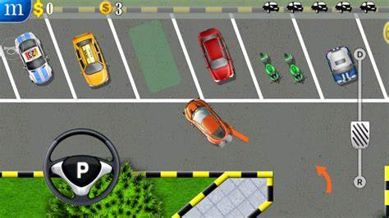
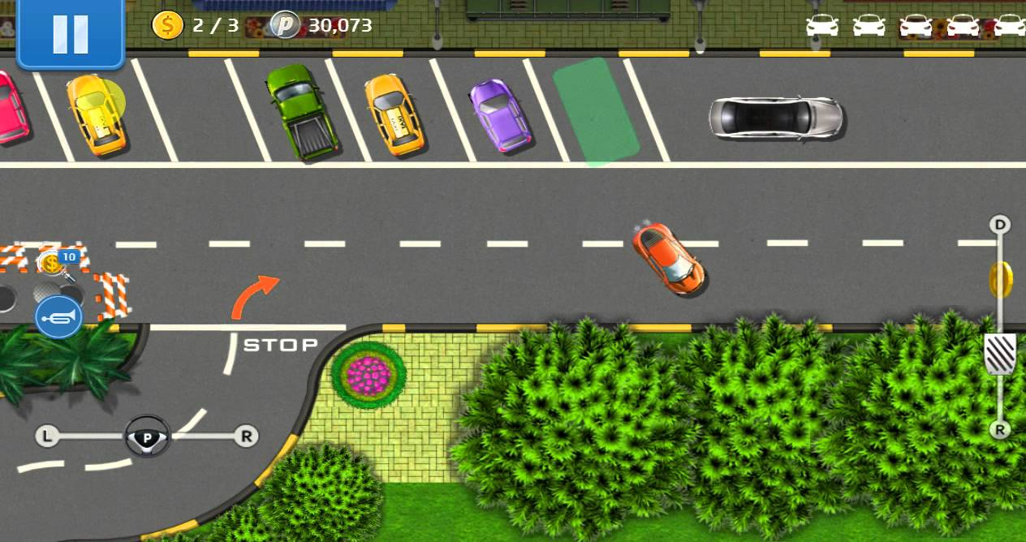
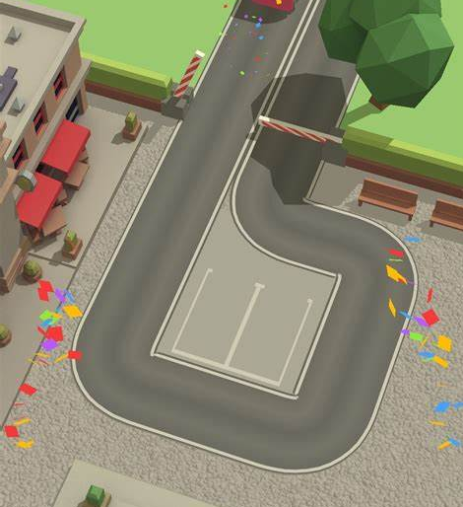
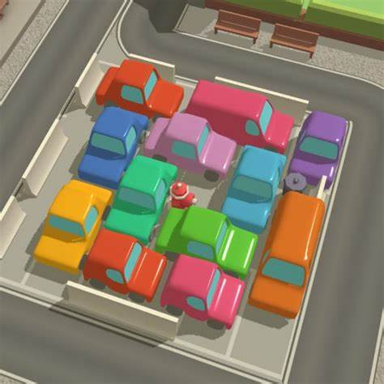
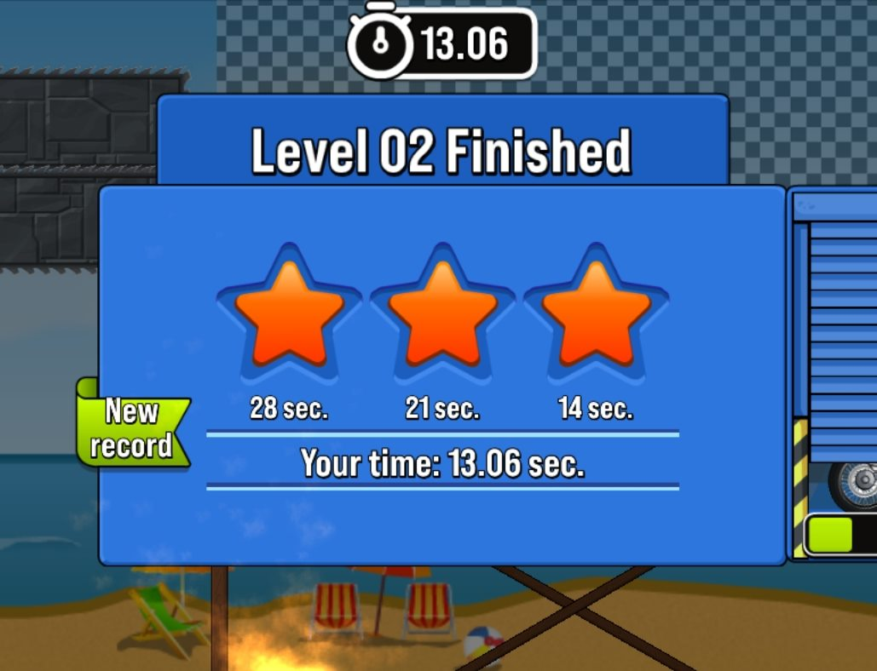
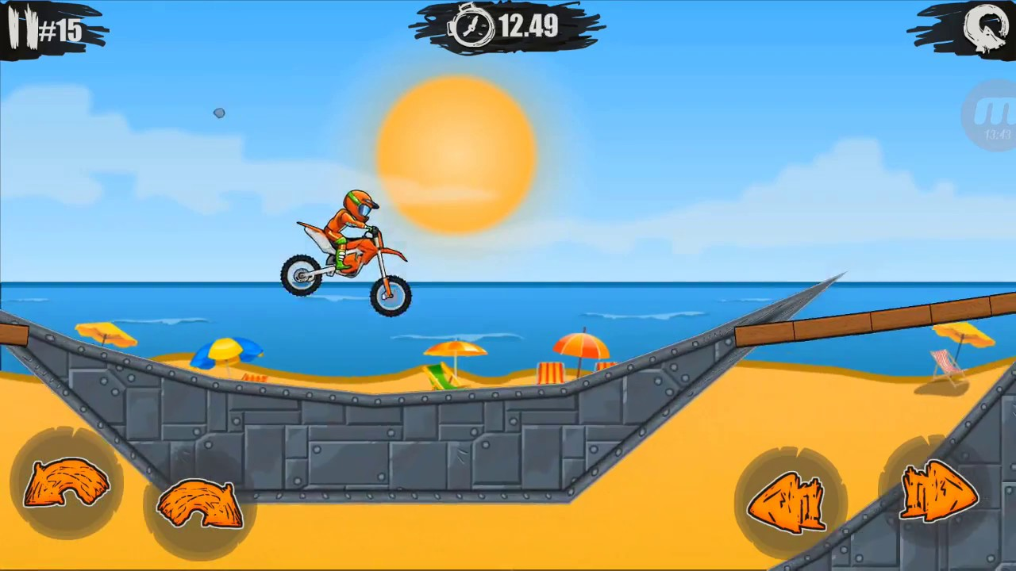
Research – Similar Games
Parking Mania – 2D top-down parking game. Players follow arrows to navigate around a layout of roads to be able to park a range of different cars in different spaces to complete levels. The game is more commonly for mobile or online use – whereas I will be making a computer form. An idea that I would like to use from the game is the player's lives – there is up to 5 different "lives" that a car has before it completely crashes. A life will be taken off when hitting other cars, the edge of the road or running a red light. I could use this idea in my own game by adding a health bar give players more difficulty when navigating around. Furthermore, I would like to integrate the idea of moving onto different road layouts when hitting the edge of the screen to make longer and more complex levels.
Parking Jam – 3D traffic puzzle parking game. Players must release all the cars from the grid to complete the level and they become harder the further along in the game. Although the physical gameplay isn't exactly what I have in mind, I would like to use the more cartoony and colourful graphics to appeal to a younger audience with my game. Furthermore, if I wanted to incorporate mini games into my overall game to further rewards – the parking puzzle solving could be a contender. Furthermore, the game has no music which I would like to add for a better experience.
Moto X3M – 2D motorcycle driving game. Players accelerate and decelerate up hills and perform tricks to complete levels in the shortest time. I like the timed feature of this game where stars and rewards at the end of each level are decided by how quickly you finish the game. This could be implemented alongside a coin method for getting rewards for newer cars in my own game – as they are in this game.

Slide 5
Similar Games - summary
Game | Areas I like | Areas I do not like
Parking Mania | Top-Down Gameplay, allows for easier controls Limited Health, add a health bar Expanded levels for more exploration | Textures are too realistic for my liking. Mobile App/Online
Parking Jam | Cartoonish Design Potential side minigame for my game | Not the main gameplay Mobile App No music incorporated
Moto x3m | Rewards based on finishing time. Unlock new vehicles from completing levels | Mobile App/Online Not the main gameplay
How to implement in my game?
Parking Mania – The general 2D, top-down, single-player gameplay and expanding level maps will be the main gameplay and I will adapt the lives bar idea for damaging the player's car to a health bar . However, there will be added areas such as minigames and less realistic graphics from this game.
Parking Jam – The cartoonish and colourful design is a feature I would like to use in my game. And the puzzle car game could potentially be a minigame idea. The lack of music in the game has pushed me to want to add music to my game.
Moto x3m – The approach to unlocking new vehicles using stars earned from finishing times would be good way to implement virtual currency into the game.
All three games are primarily mobile apps whereas I would like to be on computers and therefore will implement WASD/Arrow keys and mous to drive.

Slide 6
Stakeholders
My target demographic would be secondary school children and late teenagers from the ages between 14-18 – who would be interested in a fun parking game. I will make the graphics more colourful and brighter to make it more comical and less driving simulator-like. As well as being an enjoyable game to play, I would like to spread awareness of road safety and begin subtly develop parking practice with younger people. This would include navigating around traffic lights and turns whilst also not hitting curbs, potholes or other vehicles. Despite its cartoon-like appearance, it will feature some rules on the road to an extent of remaining fun to play whilst also sharing some educational knowledge of how the road works – this will further help younger children become more aware of road safety.
I will ask stakeholders inside and outside my target demographic for their opinions to further enhance my gameplay and make it more appealing. I will continue to incorporate my stakeholder’s opinions and ideas throughout the creation process to further build my game to be more functional and appealing.
Name | Age | Interests | Statement
Linden | 10 | Video Games such as Roblox and Minecraft | “It should be easy to play so that I can play often”
Willow | 34 | Cars | “The cars should be easy to drive and navigate and follow the rules of the road”
Evelyn | 15 | Art, Painting | “I would like many customization options”

Slide 7
User Requirements
Upon opening the game, it will load a start menu that has the option to play levels, customise car and turn audio off.
Each different option screen (levels, customisation, etc) will have an option to return to the home screen.
I will create 2 different levels for this game; each will have an explorable and colourful map where the player must navigate to the correct parking space in a car.
The cars will be customisable in different colours to allow the player more personalisation.
The W, A, S and D keys will be used for the car to move. The car must move forward to turn like a real car.
The car will have health when the level begins that will be reduced when the car: hits the curb, hits a pothole, hits another car or runs a red light. Finishing with different amounts of health will give the player different rewards.
The game could be timed to give stars to players more rewards such as new colours for car customisation.
The game can have minigames integrated into the levels that can give further rewards that relate to the theme of cars and parking.
When the car reaches the end goal, a level end screen will appear that tells the player their score and rewards.

Slide 8
Success Criteria
 | Feature |  | Sub-feature | Purpose | Justification | Importance
1 | Menu | a | Game title | Introduces the player to the game on the title screen. | The games that I researched included bold and interesting titles to introduce the player to the game and tell the user what kind of game they are playing. I will incorporate this into my game | Essential
 |  | b | Option buttons | Each button will direct to a different feature of the game. For example, one button opens to the levels screen, and one opens the customisation. | To use my game easily, the player must be able to access the real gameplay. Therefore, they must be fully functioning and easy to navigate to find the correct path. | Essential
 |  | c | Sound settings | This will be used to allow the player to control how they play music. | Sound may not always be wanted – such as in public or at night. Therefore, including a setting for a muted option will extend the amount of time that the player can play for. | Possibility
 |  | d | How to Play Menu | This will tell new players how to play the game, such as the controls and main aims. | Some controls may be hard to know without playing the game before, such as where to drive or what buttons to press. | Essential
2 | Gameplay | a | Car movement | Allows the car to move around the map. | The similar games that I looked at that had options for online use often used arrow-keys or WASD keys to drive the vehicle. Since this is a commonly used set, I will use this in my game to help it be easier to understand. | Essential

Slide 9
Success Criteria
 | Feature |  | Sub-feature | Purpose | Justification | Importance
2 | Gameplay | b | Turning | The car should be able to be turned around corners in a realistic way like an actual car. | For example, not allowing the car to turn without moving forwards. This will add more realism to the game to real life. | Essential
 |  | c | Health | Adds an element of danger to the game which allows cars to be damaged by potholes, curbs, and other cars. Depending on how much of the health is remaining at the end of the level, the player will receive rewards. | Much like the star system in Parking Mania (one of my similar games), I will incorporate a health system to be able for the car to withstand some tear until it is completed restarted. This not only makes the game more difficult but also adds a sense of realism. The health system will be out of 100 but can be shown in numbers and as a health bar to be easier to find and spot by the player. | Essential
 |  | d | Parking | The main purpose of the game is to park the car into a highlight parking space. This space will be highlighted and once the car is inside, the game will finish. | This space will be highlighted and once the car is inside, the game will finish. The space must be illuminated for the character to know where the player must drive to. Other similar games use arrows throughout the level to direct into the correct direction. | Essential
 |  | e | Minigames (see slide 12) | This would be implemented into the levels to allow the player to gain more rewards in their games. | Types of minigames can be implanted in similar styles to the similar parking themed games that I played – such as the parking puzzle game. As these rewards will be important in unlocking customisation, it would be interesting to add an opportunity to make more. | Possibility
Notes:
Criteria for minigames, only do 2 //
Parking criteria – area of parking, how to navigate around, //
How will health effect the gameplay – what happens if health becomes 0//
Different difficulties of levels //
End of level screen //

Slide 10
Success Criteria
 | Feature |  | Sub-feature | Purpose | Justification | Importance
2 | Gameplay | f | Timings | This would be another element to the game that would reward the player depending on how quickly they completed the level. | Taking the timing idea from the Moto x3M game, the timings will again allow the players to get more rewards that can go towards customisation. However, this would need an element of time to be added to the game. | Possibility
3 | World | a | Gameplay Map | Provide a backdrop for the car to navigate around. | Influenced by the game parking mania, I will implement the feature which allows maps to be extended once reaching the edge to be able to have more complex and interesting maps to explore | Essential
 |  | b | Other Cars | Other cars will provide obstacles for the player to navigate through. | Adding other moving and parked vehicles will increasing the number of obstacles for the player to encounter. | Essential
 |  | c | Level Difficulties | Each level will have varying difficulty to provide more challenges to the player. | Taking ideas from similar games like Parking Mania, there will be differing levels of difficulty by adding more complex structures of maps, more cars for the player to face and more intricate parking spaces (such as parallel parking). I will create two different levels of varying difficulty to display a variation of difficulty. | Essential

Slide 11
Success Criteria
 | Feature |  | Sub-feature | Purpose | Justification | Importance
3 | World | d | End of Level Screen | Shows the player whether they have completed or failed the level. | If the health becomes 0, then the game level will reset to the beginning. If the player becomes victorious, then an end screen will show that informs the player of the rewards they received from the level before returning them to the main menu. | Essential
4 | Customisation Menu | a | Car colours and types | This will allow the player to choose from a select number of different cars to drive. | To allow more creativity and personalisation for the game, adding different car colours will fulfill my stakeholders want of being more customisation options. | Essential
 |  | b | In-Game Currency | This will provide a system for purchasing customisations for vehicles. | The game currency can be increased and decreased by playing the game and purchasing new upgrades to help with the sense of realism as well as adding personality to the game. | Essential
5 | Sound | a | Music | This will add background music throughout the game. | Through my research, I discovered that the games with music made it more enjoyable and more peaceful which makes me wish to implement into my own game. However, there should be an option to turn off the audio. | Essential
 |  | b | Sound effects | Typical car sounds can be added such as horn honking or a car engine starting. | This would make the game more realistic. | Possibility

Slide 12
Mini Games Criteria
Seagull Pooing Game Idea
Parking Puzzle Game Idea
 | Feature | Purpose | Justification
1 | Menu | The game will load up with its own title screen introducing the game. | The games introductory screens will be self-explanatory and easy to learn so that players can play easily between levels. This game will be popular with the younger demographic due to its comical nature.
2 | Map | The game will be in a child-friendly comical style | Due to the comical nature of the game, having a colourful and cartoon-like design will not only be more suited to the younger demographic but also further improve the comical elements.
3 | Gameplay | The seagull will be controlled by the A and D keys to move side to side and defecate on people below walking across. | The interesting game idea would provide a fun side game to the original gameplay that is more comical. The minigame will be more targeted at younger children who enjoy more informal topics. It could be made more natured to the overall game by including defecating on cars.
 | Feature | Purpose | Justification
3 | Menu | The game will load up with its own title screen introducing the game. | The games introductory screens will be self-explanatory and easy to learn so that players can play easily between levels. This game will be more targeted at older ages as well.
4 | Map | The game will remain colourful in the style of the main gameplay but have more sophisticated gameplay. | The minigame will be suited to the more colourful style.
5 | Gameplay | A randomly generated puzzle of parked cars will be made. Players must remove cars one by one until all cars are removed. | This puzzle game is inspired by my similar game research on "Parking Jam" - however, I will make it my own version of the popular puzzle solving game.
 |  | The cars will be clicked to remove them. | The cars will be clicked by the mouse to remove them from the puzzle. This is very simple for easy gameplay.
Limitations: These games may be tricky to implement as I may not find time to include them in my project.

Slide 13
Limitations
I had considered some features of my game as “possibilities” that could be considered if I have spare time or continue my game in the future. These include;
Levels:
In my current game, I will only create 2 levels as I think it would be better to spend more time on other development stages rather than creating more level ideas. Therefore, I will make the levels have varying difficulty to give a good example of my game. If I were to create a full game, there would be many more levels. I also know that Greenfoot is quite time-consuming in creating levels so I will try to only make a couple.
Timings:
The timing feature that I liked from my similar game Moto X3M is a feature that I could potentially add to improve the gameplay of my game. It could make the levels more interesting that simply traveling to the final spot as completing in certain times would improve the score for the player. However, I have put these as limitations as it is not a necessary feature for my original idea to work and will take a lot more time to implement due to needed an element of a time. Therefore, I have left this as a possibility to add to improve my game in the future.
Sound Effects:
The sound features from my sample games proved to be a fun addition to make the game more child-friendly and fun to play. Although it is a feature I would like to add, it may be more difficult to add due to needing to find a way to add sound to the Greenfoot platform. Therefore, I have put this as a potential element to add in the future to add a fun sounds to my game.
Mini-games:
Initially, I was very interested in adding a way for players to gain greater rewards from the levels such as smaller minigames. However, although I have thought about potential games to add, it seems it would take way too much time to implement as it involves a whole new game to be created – this could also push the limits of the Greenfoot program which does not seem to be the most equipped for larger games. Therefore, I have put it as a potential feature that could be added if I had more time as well as a higher specification coding environment.

Slide 14
Hardware and Software
Hardware:
The Greenfoot IDE requires some features to run smoothly:
Free Disk Space = 1.5 GB (Recommended 8 GB)
Memory = 1GB
Processor = Pentium 4 or higher
Graphics = Anything capable of high colour and 1024 x 768 resolution
Browsers: Chrome, Safari, Edge etc.
Software:
Currently, the Greenfoot software is required to play my game as it is saved on the Greenfoot coding environment. However, Greenfoot does allow to export the project to their online game platforms as well as exporting it a Greenfoot project. I can use this in the future,

Slide 15
Computational Methods
My project is suitable to be solved with a computer for several reasons;
Decomposition: My game will be broken down into smaller parts to make it easier to manage and maintain. Due to my use of object-oriented code in Greenfoot, the project will be broken down into different worlds and objects that will work and interact with each other and the player to create the game. Furthermore, by breaking it down with decomposition, I can easier test my code and identify any problems that prevent the game from functioning correctly.
Concurrency: My game will also feature concurrency as there will be other features such as moving cars and pedestrians that will be moving in my game at the same time as the player. Furthermore, the code will need to run several lines concurrently to identify if the car has had a collision and damaged health. This aspect becomes much more efficient when using a machine compared to humans.
Visualisation: A primary aspect of my game will be the colourful display of the game. The game interface will be an easy-to-use map that allows the player to move around on. This will allow the player to visually see the movement of the car and understand how to avoid the obstacles.
Information Hiding: As my game will be created with Object-oriented code, the interface of the game will be a simplified version of the code for the player to better understand the aspects of the game. The players will not see any of the process of the game occurring but simply enjoying their time navigating the visual elements of the game.

Slide 16
Initial Design

Slide 17
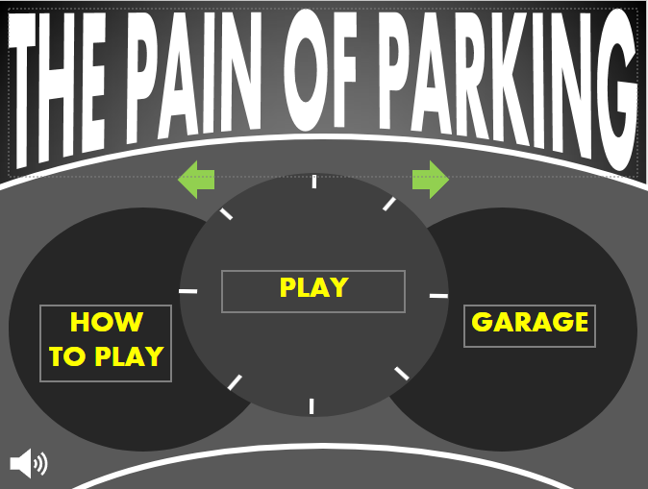
GUI – main menu
Title
I have chosen to have the title in bold and white so that it is easier read in contrast to the dark background. The font "Abadi", is very clear and easily read.
Main Buttons
These buttons will switch the worlds to the chosen destination; how-to-play, level screen and customisation garage. I have chosen them to be yellow to be able to stand out from the regular white accent colours to show that they are buttons.
Mute button
This can be clicked on as a button to turn off music – where it will change its appearance to represent being muted. The icon is also white to compliment the other white accents and stand out from the grey backgrounds.
Background
I styled the background to be based on a car dashboard to reflect the car theme of game. The various shades of grey for the background and dials.

Slide 18
GUI – game map
Home Button
This button will stop the game and return to the home screen. It is a commonly recognised home icon for familiarity so it would not need to be in the "how to play" section.
Health Bar
This bar will determine the player's health. As the player crashes, health will be reduced until the car is totaled. The bar being in the corner of the screen reduces the chances of it being distraction or overlapping during the game.
Background
The background being very light and pastel colours allow the player to focus more on the road and car. I have added similar road markings and signs such as give way signs and Belisha beacons for more realism.
Obstacles
I have added multiple obstacles that could reduce the players health, this includes a pedestrian crossing, potholes and other moving vehicles.
Extending maps
Screens should extend past the screen for larger and more complex levels.

Slide 19
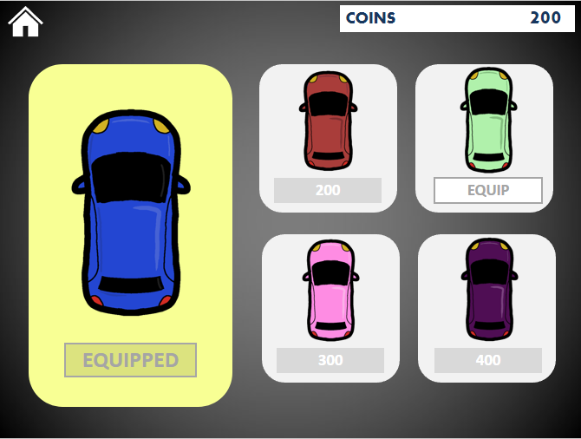
GUI – customisation menu
Home Button
This button will stop the game and return to the home screen. I have kept it in the top corner so it is easily recognisable in each screen.
Coins
The coins box is important to tell the player how many coins they have earned. It is clearly presented using the white box in the top corner, similar to the health bar.
Background
The grey theme is carried through from the main menu screen to continue the main theme.
Purchasing/equip buttons
Once a new car customisation is bought, the button changed so the player can equip the new car. Prior to purchase the price of the new cars are inside the button. I have made each button type different to be able to identify easily when the player has purchased the car.
Vehicle Preview
The current playable vehicle is previewed on the left in yellow. I have added it separately to highlight which is the currently used one in contrast to not used ones. If no other cars are selected, then it will default the blue car.

Slide 20
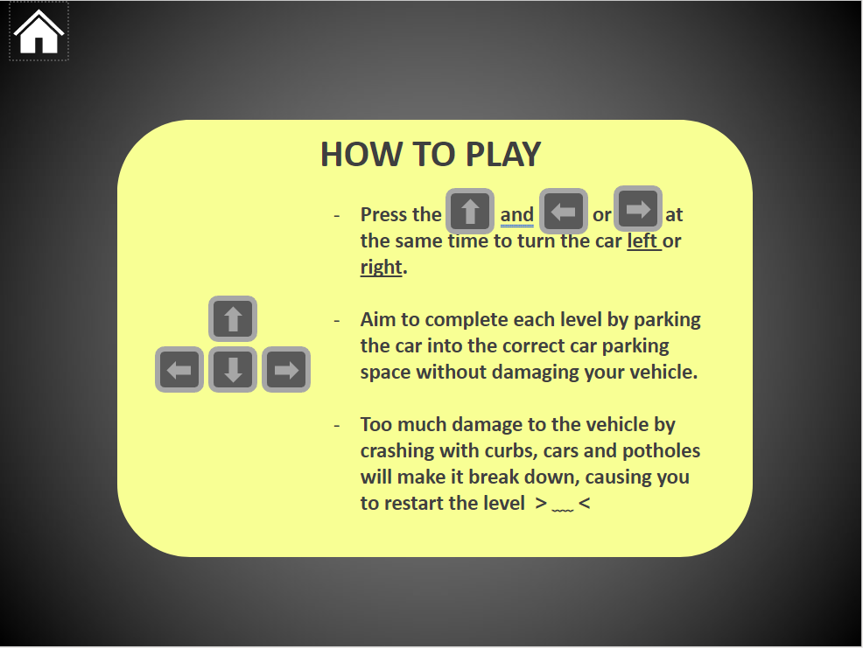
GUI – how to play
Home Button
This button return to the home screen.
How To Play
I added this screen to help with navigation the main game.
Background
I have continued the background from the original menus to maintain the basic menu theme of the game. The yellow background from the main body allows the text to stand out, as well as being similar to the customisation menu.
Illustrations
I added simple illustrations to add more visual elements. It breaks up the text and helps explain the game simpler.

Slide 21
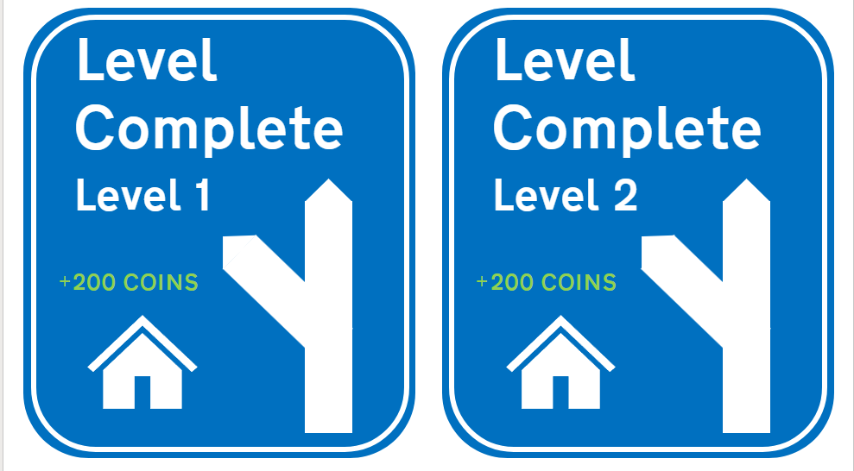
GUI – end of level screens
Background
The blue signs compliments well with the pastel green and greys of the gameplay map. This will make it easy for the player to identify the pop-up when completing the level.
Title
I made the font clear and large so it is easily read whilst maintaining a font that is similar to real traffic sign fonts. The menu popup will also include the level name that was completed.
Earnings
The sign will say the number of coins earnt from each level on the pop-up. I made this font green to stand out from the blue background as well as signifying a gain in money.
Theme
I made the menu to represent a road traffic sign, this continues the car theme of the game.
Home Button
This button will return to the home screen. I have kept the same icon from other areas of the game so it would be easier for the player to return to the menu and choose another level..
Pop-Ups
These menus will be brought up when the car is parked in its final position.

Slide 22
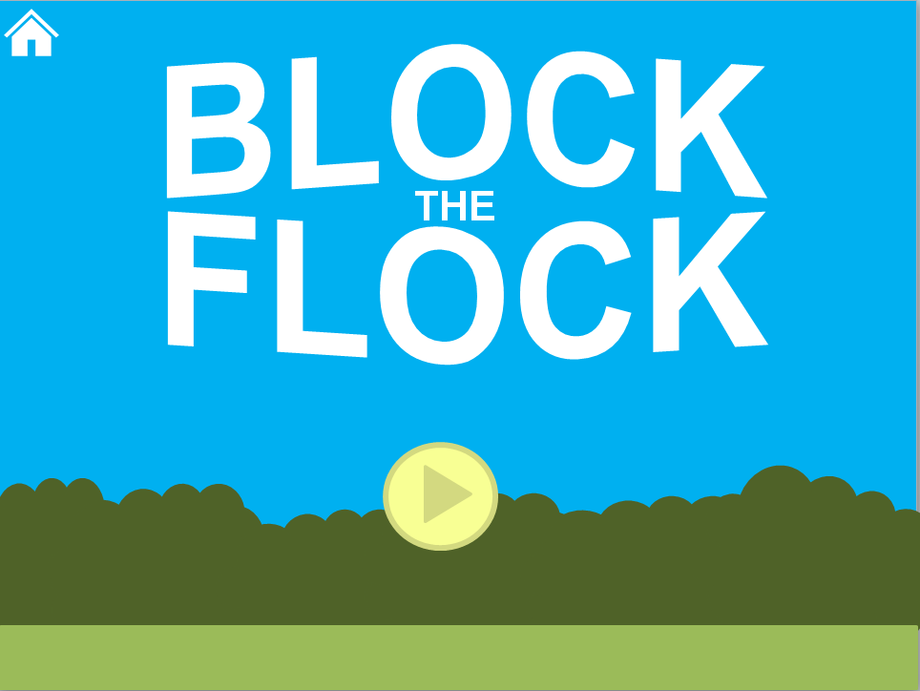
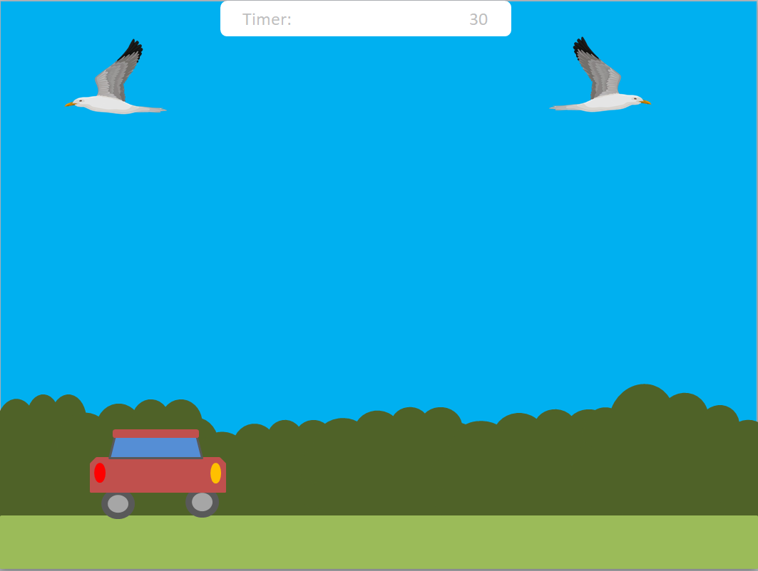
GUI – minigame (potentially)
Title
The title screen will have the game title in big letters to introduce the game.
Timer
The timer will add a new time counter element into the game. I added the timer to the top screen to make it easier to view the countdown.
Home button
The home button will be in similar position to other areas of the game. This will give players the opportunity to skip the minigame.
The Seagull
The seagull in the game will also move from side to side – to which the player must avoid their poo from hitting the car. The lightheartedness of the minigame and bright colours could attract a younger demographic.
Car
The car can be moved by the player from left to right easily using the same controls as the main game. This similarity makes it much simpler to learn this minigame.
Background
The background will be simple yet colourful. I have chosen strong blues and greens to create a greater diversity in colours from the grey menus and be more appealing to the player.
Play button
I have chosen the button to represent the common designs for play buttons so it is easier to understand and access the game.

Slide 23
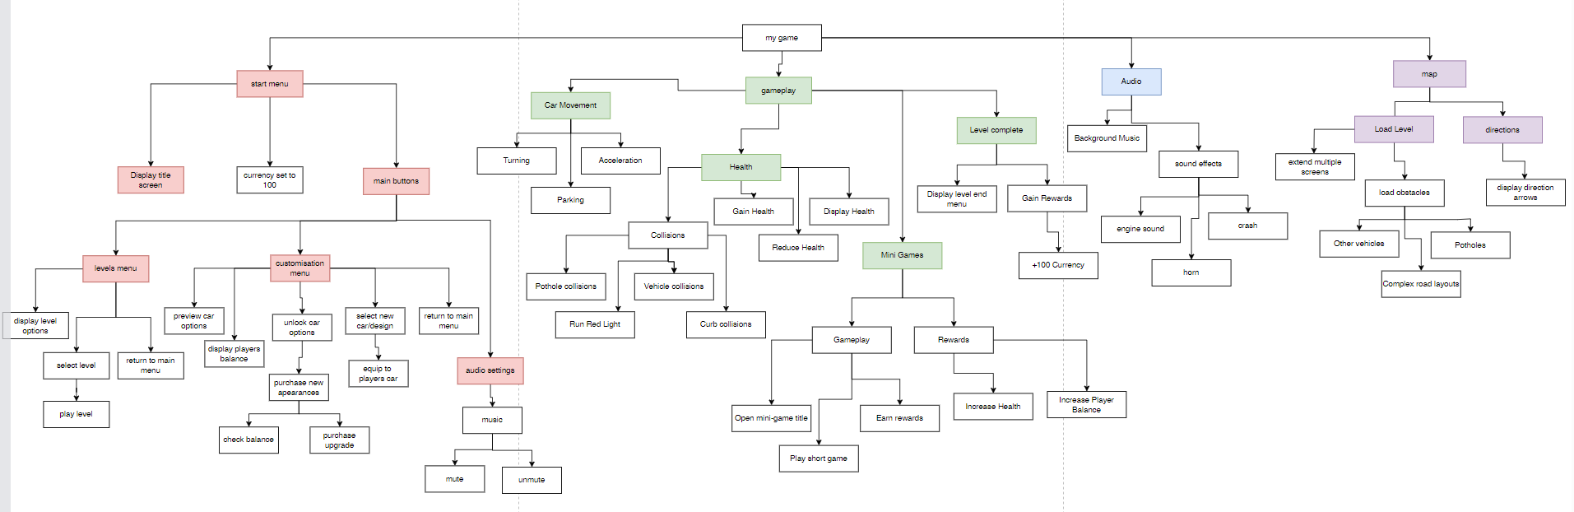
Structure diagram

Slide 24
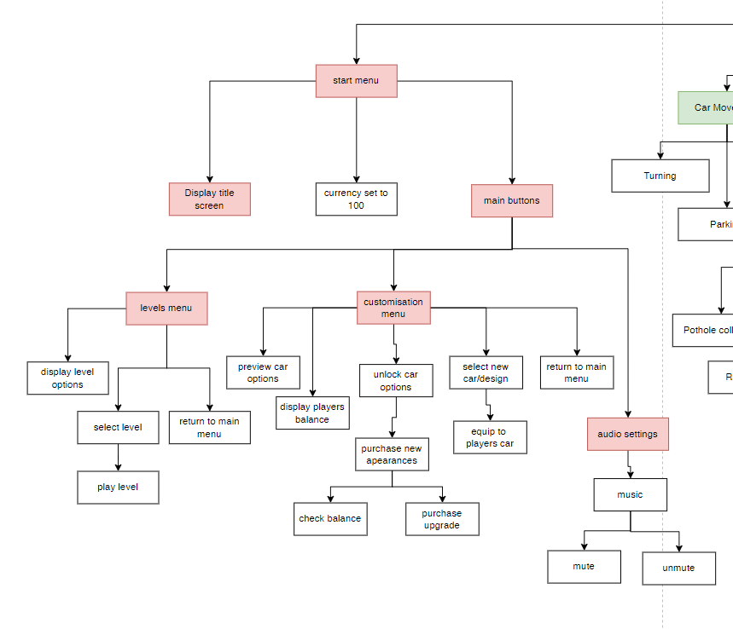
Menu

Slide 25
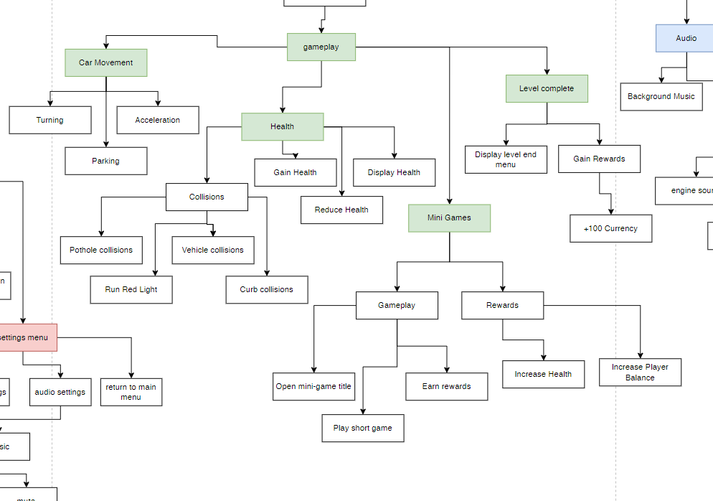
Gameplay

Slide 26
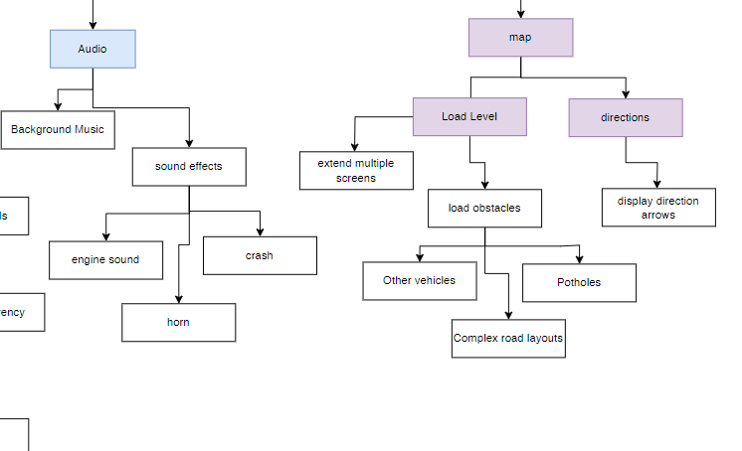
Map and Audio

Slide 27

Development Plan
No. | Feature | What? | Time | Estimated Dates | Complete?
1 | Menus | Designing the main menus; start, customisation, levels Creating Functioning link buttons | Medium | 12 SEPT – 22 SEPT | 🗸
2 | Car Movement | Accelerating Turning | Short | 22 SEPT – 29 SEPT | 🗸
3 | Game Map | 2 Map Designs; curbs, parking spaces, crossings Enemy obstacles; pedestrians, cars, potholes Decoration; trees, traffic lights, signs Car sizes | Long | 29 SEPT – 20 OCT | 🗸
4 | Finishing levels | Parking End screen | Medium | 20 OCT – 4 NOV | 🗸
5 | Vehicle Damage & Health | Vehicle Damage Hitboxes Health Bar Restarting Level | Long | 4 NOV – 24 NOV | 🗸
6 | Currency | Game rewards Purchasing Cars | Medium | 24 NOV – 5 DEC
7 | Customisation | Equipping Cars Using Cars in levels | Short | 5 DEC – 12 DEC | 🗸
8 | Audio | Background Music On + Off switch on Main Menu | Short | 12 DEC – 15 DEC | 🗸
9 | Mini Game | Link to main game Map + Menu Design Simple Game controls + Graphics | Long | 1 JAN – 14 JAN
Basic Elements of the game
Could require more time
Final Deadline:
6th March

Slide 28
Development

Slide 29
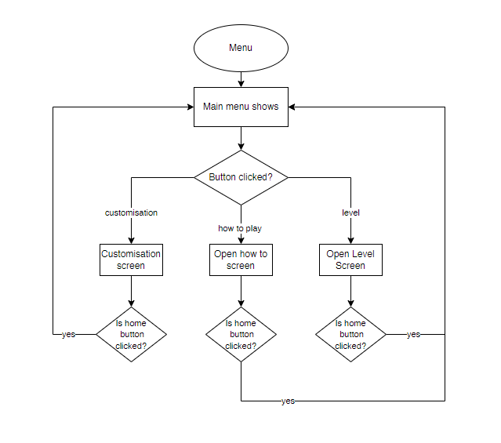
Section 1
My first section will be developing the start menu screens and making sure the screens can move between each other smoothly. I have created a flowchart and used my previous GUI designs to help create this section.
Flowchart:
The flowchart shows how the movement between menu screens should function. I will create this using buttons to different worlds on Greenfoot.
GUI Designs:
I replicate the GUI designs inside of Greenfoot to be my menu screens.

Slide 30
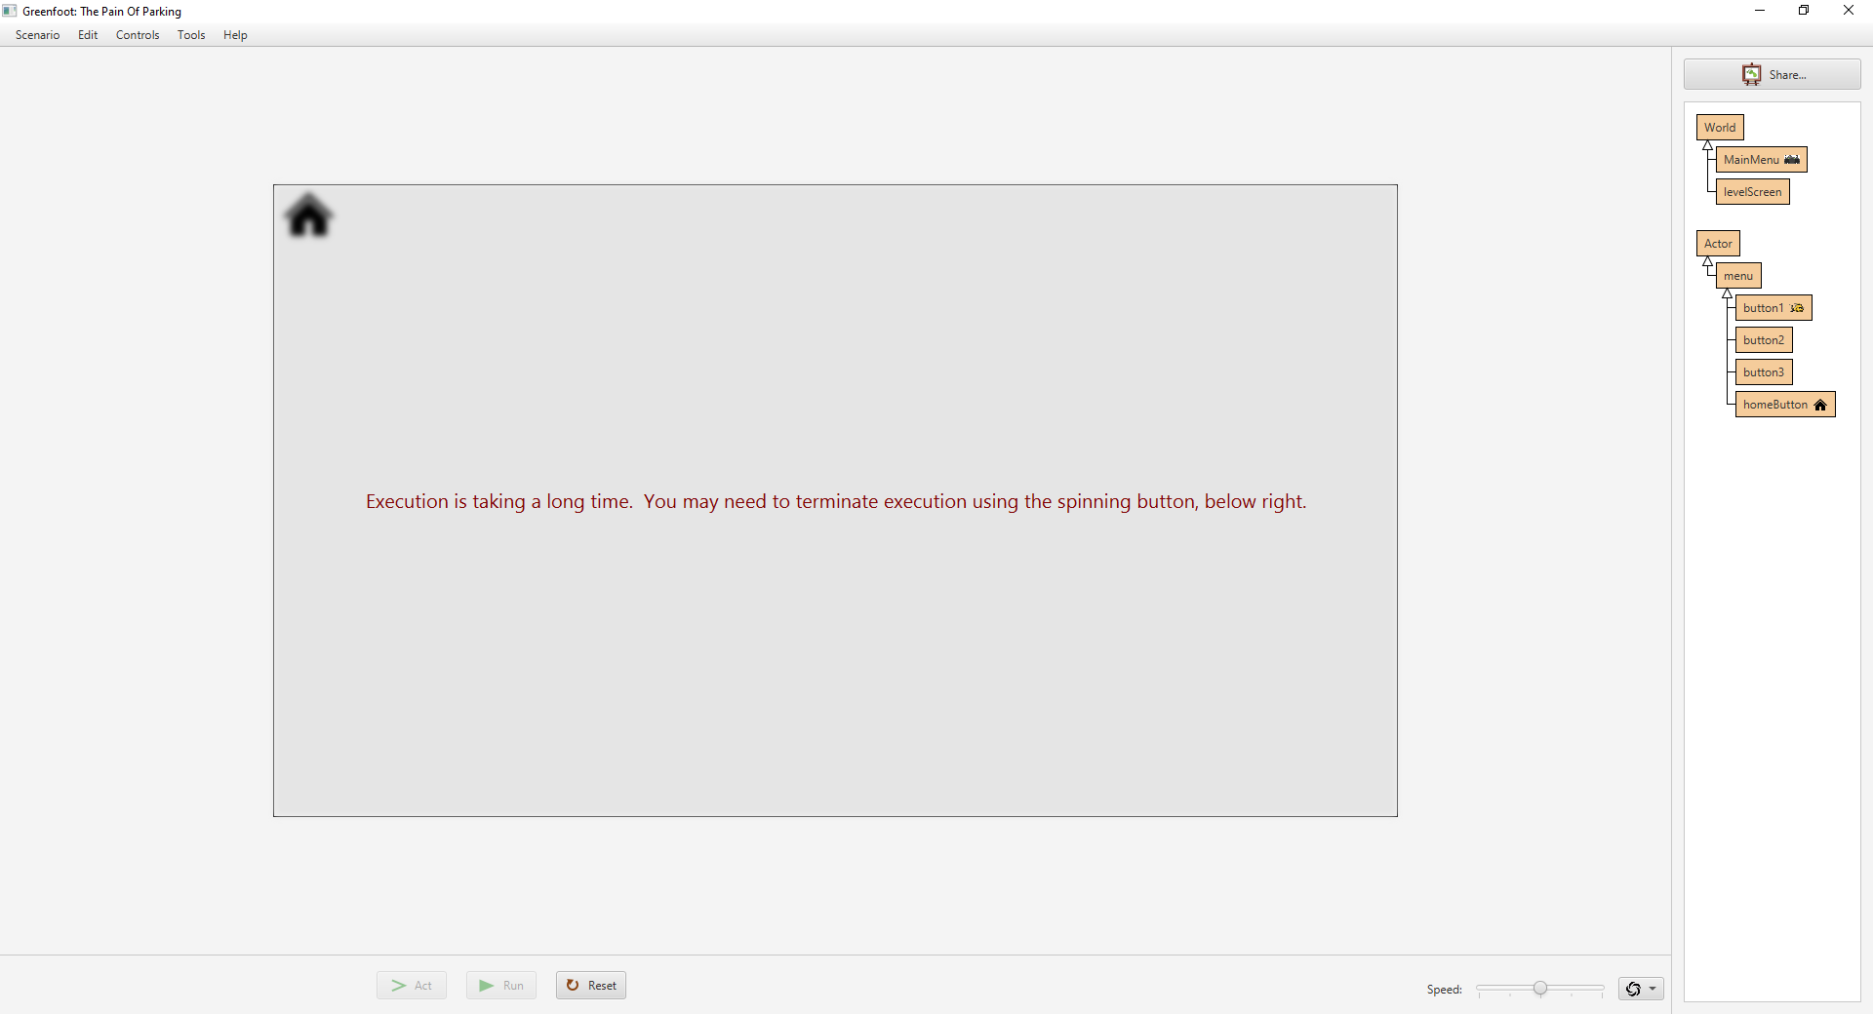
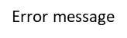

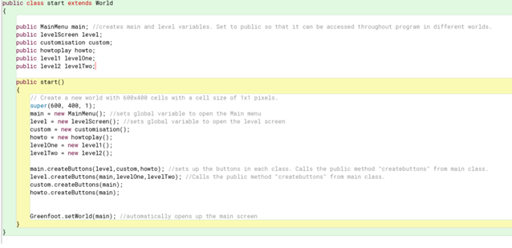
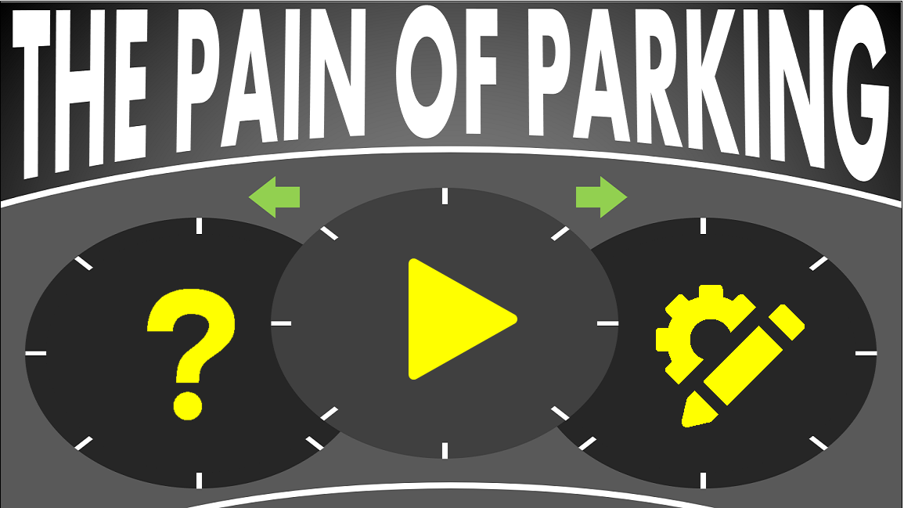
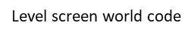
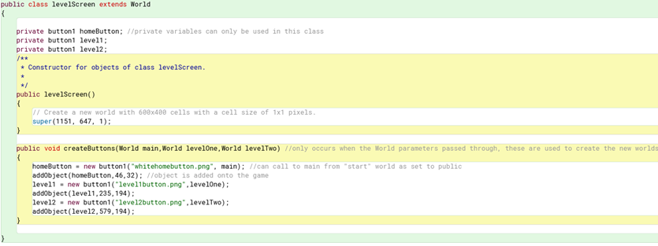
Section 1
Problem #1 – Endless loop of home screens
When coding my "home screen" button, encountered a logic error where my buttons seemed to loop eternally when trying to return to the main menu from the level screens. This would cause Greenfoot to take too long to execute my program (as shown on screenshot) and eventually crash. This logic error meant that I needed to recover and break the loop before fixing the error.
To help to avoid making the game go into one endless loop, I followed tutorial:
https://youtu.be/OYzy2srK990?si=4IigqsGvZc3HdRHM
It helped instruct me on how to use a "start" screen to automatically open each world and create the buttons, something that I then used for each menu screen. I also added sounds to the buttons (Beep Sound).
GUI Design
I changed the GUI design to basic symbols for the basic "play", "customisation" and "how-to-play" screens. This made the screen look more aesthetically pleasing and user friendly whilst still being easy to understand.

Slide 31
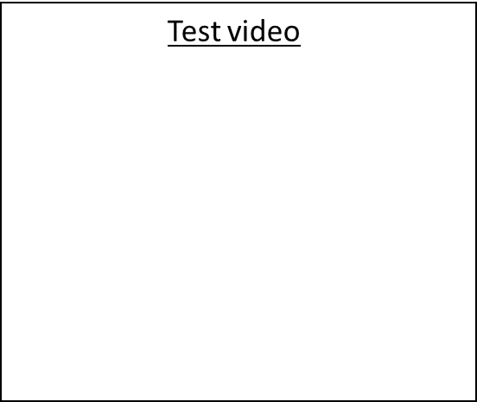

Section 1- Test Plan
1 | No. | Description | Test Data | Expected Output | Actual Output
 | 1 | Does the main menu show when the game starts? | Run Program | The Main game menu will open when the player presses the “run” button on Greenfoot. | When the project is “run” then the first screen that opens is the main menu, as directly opened by the “start” world.
 | 2 | Do the buttons function correctly? | Click on menu buttons | The buttons are clickable and navigate to the correct location. | Yes, all the buttons can be clicked on and take you to the necessary sections of the game.
 | 3 | Do the menu screens link back to the main menu? | Click the home button | The Main screen is opened again when the home button is pressed. | The home buttons are all correctly connected back to the home screen.
https://youtu.be/qhHxPgy2jhc
End of Stage review = -Although I encountered more obstacles in this section than I had expected, I feel satisfied with the functioning menu screens. The button and world looping took several hours to fix however, due to it being crucial to the game, finding a tutorial helped me solve my issue and will certainly help me in the future. The basic GUI change also improved the design and simplicity of the game. Overall, this section was completed in efficient time.
Success = 8/10

Slide 32
Section 2
My second section will be focused on the movement of the car. This will include turning, accelerating and stopping. I must ensure that the car accelerates whilst turning for more realism. No GUI is required in this section.
Pseudocode for method “movement()” =
IF UpArrow is pressed THEN
move forward
ELSE IF DownArrow is pressed THEN
move backwards
ELSE IF UpArrow and LeftArrow is pressed THEN
turn left forward
ELSE IF UpArrow and RightArrow is pressed THEN
turn right forward
ELSE IF DownArrow and LeftArrow is pressed THEN
reverse left
ELSE IF DownArrow and RightArrow is pressed THEN
reverse right
END IF
Car
+ STR image
+ movement()
- move()
-turn()
+ setImage()

Slide 33
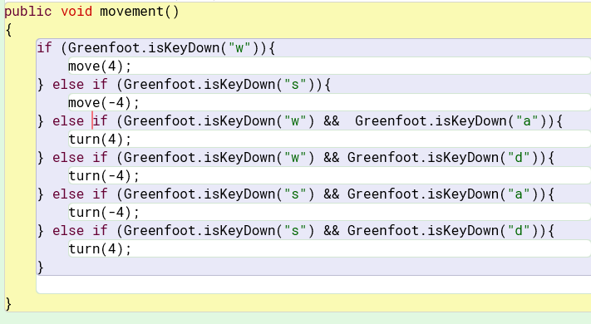
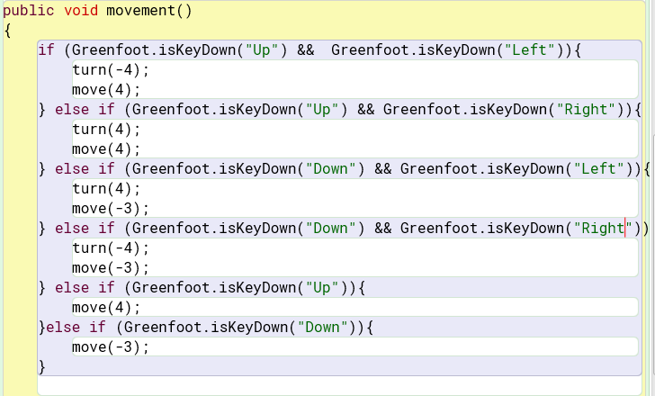
Section 2
Problem #1 – Movement
When making the if statements for the movement of my car, the first code (as pictured left) would not allow the car to turn. After some attempts, I managed to find the source of my problem being the sequence of my if statements. When I initially followed my pseudocode design, the forwards and backwards were first, this meant that if the forwards and backwards buttons were pressed, they would take power over the other turning statements – hence no turning. By changing the order, my problem was fixed (as pictured right)
Link of going video going wrong = ??
I also changed the keys pressed from WASD to the arrow keys to follow my how-to-play page.

Slide 34
Section 2 – Test Plan
2 | No. | Description | Test Data | Expected Output | Actual Output
 | 1 | Car accelerates | “Up“ arrow key pressed | Car will move forwards. | Car Moves forward
 | 2 | Car turns left | “Up” and “left” arrow keys pressed | Car will turn left. | Car will only turn left whilst also moving forwards.
 | 3 | Car turns right | “Up” and “right” arrow keys pressed | Car will turn right. | Car will only turn right whilst also moving forwards.
End of Stage review = - This section was very short as it only included figuring out the driving mechanics my game. Although I encountered a small logic error in the order of my if statement to help allow my car to turn, I solved it quickly and the section was overall completed in short time.
Success = 10/10
https://youtu.be/yKSjejuYRQo

Slide 35
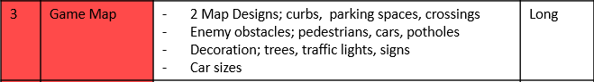
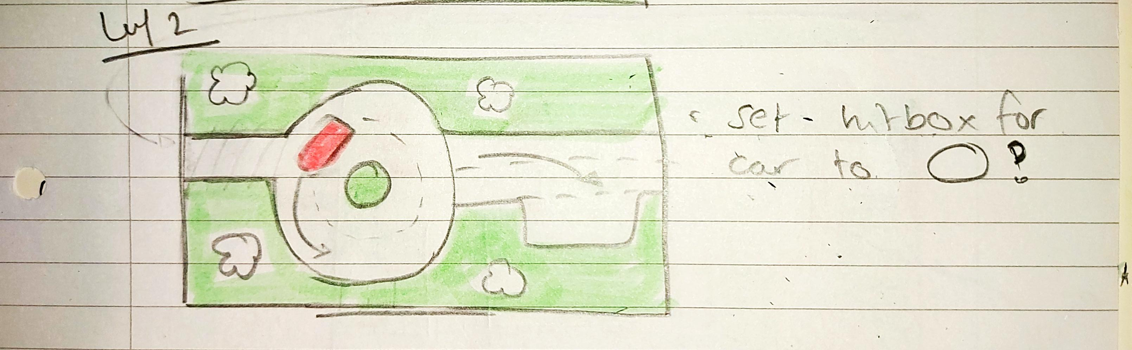
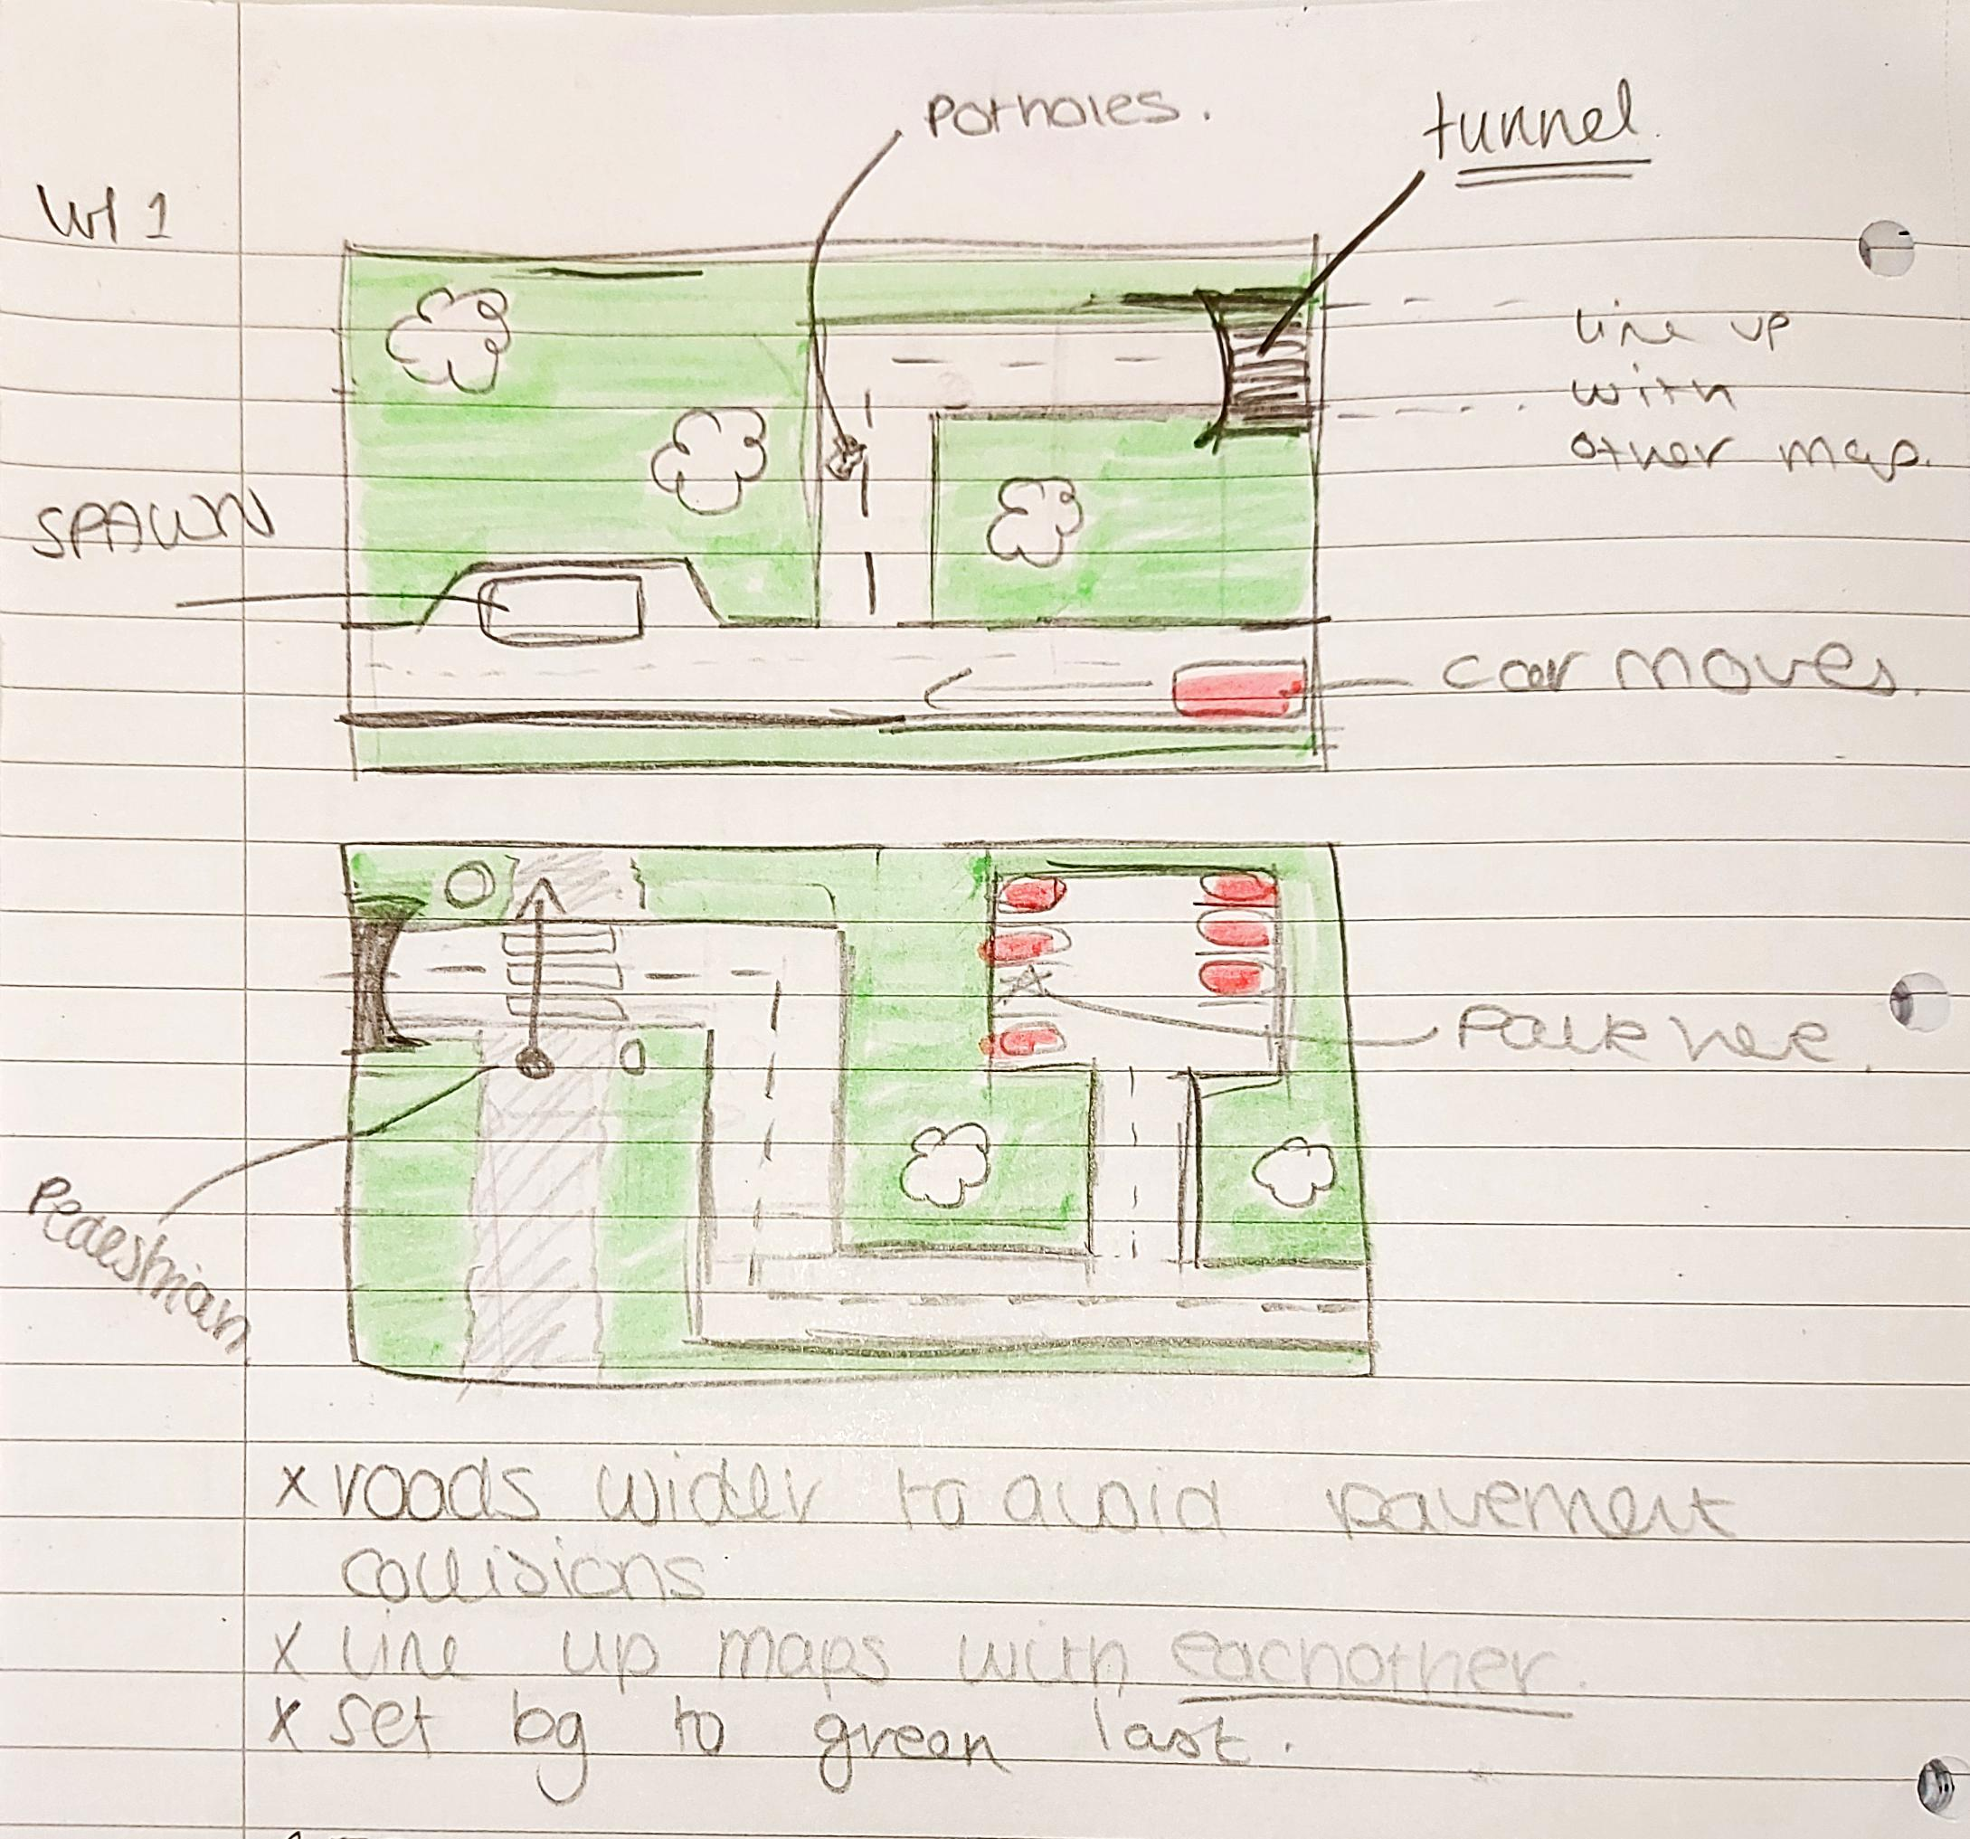
Section 3
My third section will be focused on creating the game maps for the car to move around on. Although there will be no collisions at the current time, the map will need to feature different obstacles as well as intricate map routes. I will need to design these routes before creating them for both levels. I will try to make extendable maps when the car reaches the end of the screen to move onto an extended game maps.
Level 1
Level 2

Slide 36
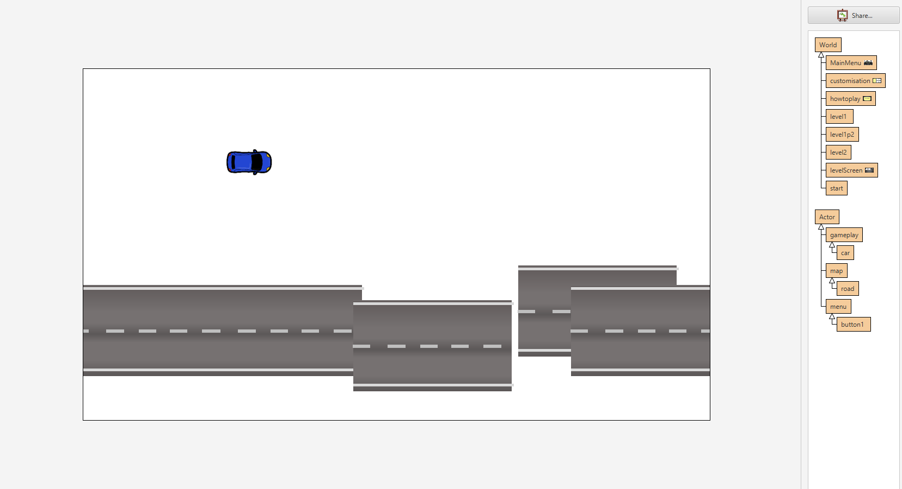
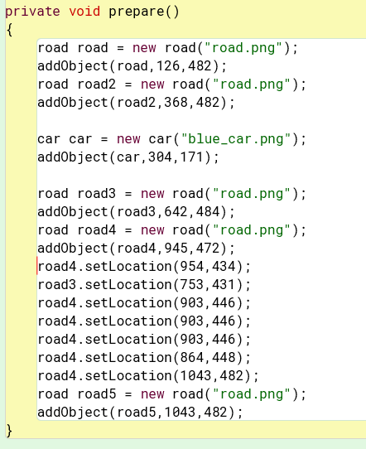
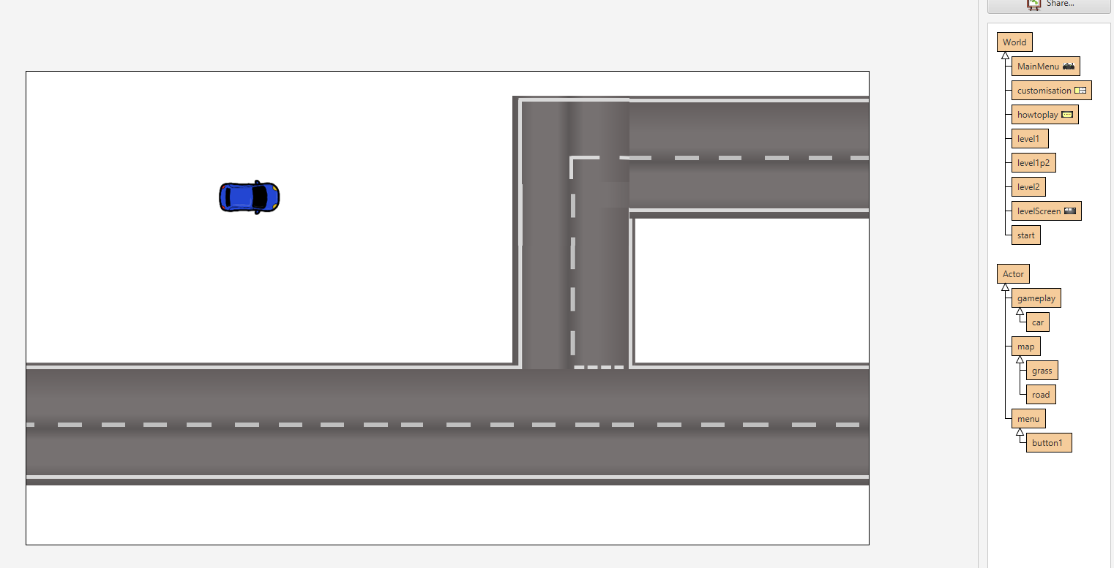
Section 3
Problem #1 – Road layout mess
When attempting to display my road layouts, I encountered a problem where the roads would get messed up each time the world was saved, even if that piece was not touched or moved. The prepare method in the world would randomly create new “set location” methods to move other road pieces. Although it was an easy fix, it was very time consuming to input each road section one by one into the code myself. This ended up occurring again through my grass and other map features on both levels.
The final level 1 road layout was completed as pictured below.
Layout after a “save world”
Final Layout
Code showing the added “set location” codes

Slide 37
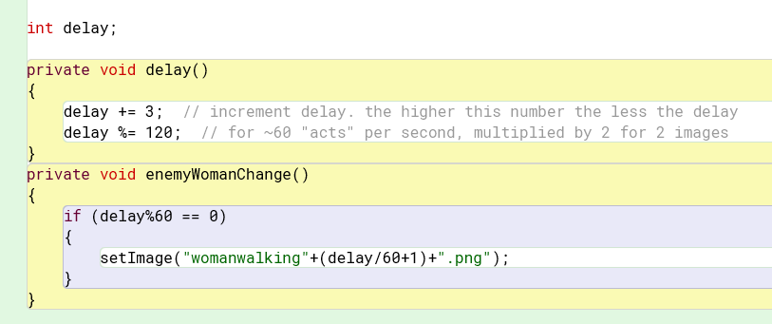
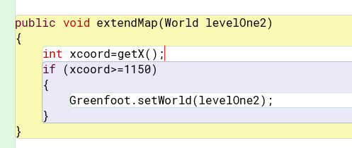
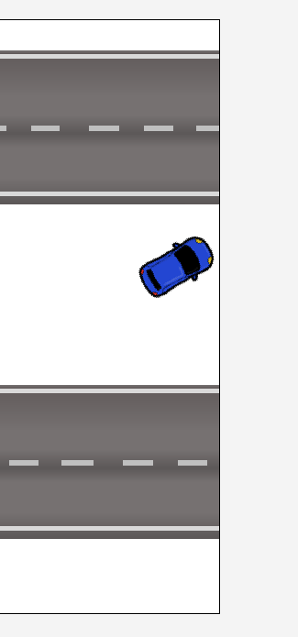
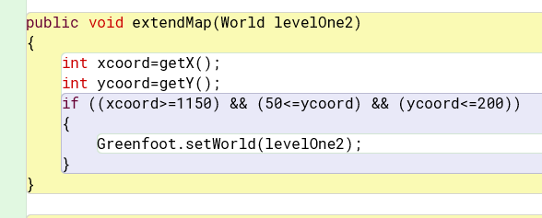
Section 3
Problem #2 – Boundary movement
One of the main aspects of level one will be the extending map screen. I originally only used the x-coordinate to navigate my car to turn to the next part of the level. After alpha testing the code, I found that this allowed the car to move to the next screen without being on the road (pictured on right).
My simple solution to this problem was to implement a Y coordinate between two points that would allow my “extend Map” method to only allow it between specific boundaries. This worked successfully and allows the car to smoothly move between screens.
The code of before and after is pictured below.
Problem #3 – Animated People Movement
To give the characters more realism, I tried to make the pedestrians seem animated. To do this I used this code in each of my pedestrian classes:
The final appearance looks like this:
Before
After
Test Video
https://youtu.be/WjM6cF5zpTU

Slide 38
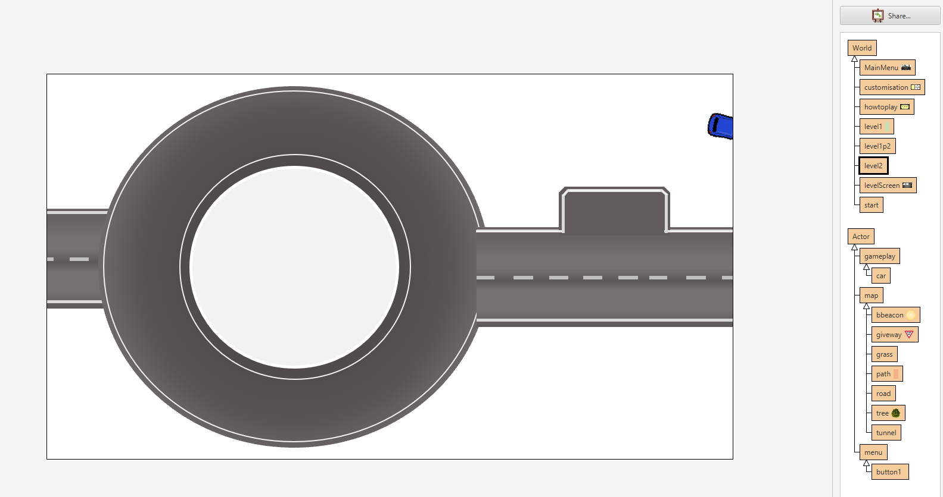
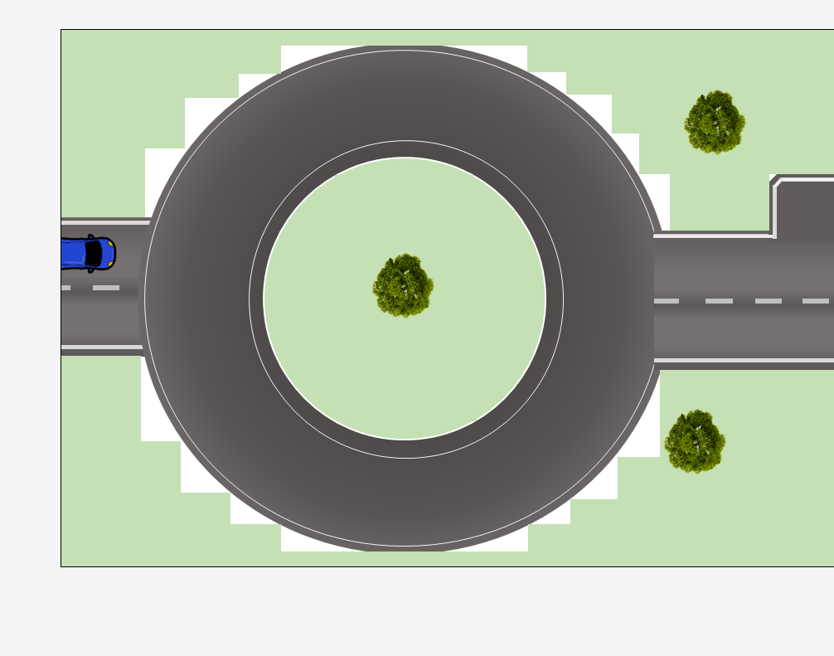
Section 3
Problem #4 – Boundary movement
As the last level had an extendable map, I found out that the next level had the same feature as it was per coordinates not per world.
The second level would also transfer to the 2nd part of level one as they were joined by coordinates rather than per world. This meant that if the car hit the same edge in level 2 (top picture), it would continue to pass to level one. As far as I had attempted to resolve it, it seems the easiest way around it is making some sort of blocker so that the car cannot drive there – however, ideally the car will not be able to drive on the grass anyway. I would have to revisit this problem at a later stage when sorting out the health.
Problem #5 – Roundabout
When placing the grass into the background, I realised that the car hitbox will not collide with the curves of the roundabout correctly. I overcame this problem by instead making small indents with square grass pieces and filling the background green to make it less noticeable. Although this does provide more leeway into hitboxes then I intended, it seemed one of the only options allowed for Greenfoot. I will further investigate this when I enter stages 5&6 to figure out more ways to create the car hitbox to avoid these problems.
Notes:
https://youtu.be/TWhhcVJQCt8?si=Gpl3TLpGmW4T5hXD

Slide 39
Section 3 – Test Plan
3 | No. | Description | Test Data | Expected Output | Actual Output
 | 1 | The car generates on the right location | Both Levels are played | The car is generated on the level and playable. | The car is first created in its intended car park.
 | 2 | The car fits on the road | Both Levels are played | Car will fit well onto the road size so that it will not crash into other cars and pavement. | Car fits well on road and between lines of the car park.
 | 3 | The map expands | Car reaches the side of the map | The car will be able to drive further beyond the first boundary of the level. | The car goes to the second level screen when the edge of the border is reached (fixed after testing as problem #2)
 | 4 | Car does not disappear off the screen | Car reaches side of the map | The car, unless moving to an expanded boundary, will not disappear from the screen. | The car does not regularly move off of the map, however, due to the coordinates from level one, the car can go back into the finishing end of level 1.
 | 5 | Obstacles appear as intended. | When map is loaded | The pedestrian walks across the map, the pothole appears on the road, other cars move on paths. | The obstacles all move correctly across the level screens.
https://youtu.be/AybmH4UxU6E
End of Stage review = -This stage of my game had many difficulties due to the map designing element of the game which added a lot longer time onto section 3 than I had initially thought. Although many of the problems were easy to fix, they were very time consuming to implement and I feel as if I had used another development program it may have been finished quicker. There are also more developments that I can do with making the pedestrians animated or have a randomizer for choosing coloured car. (potential tutorial link: https://youtu.be/TWhhcVJQCt8?si=Gpl3TLpGmW4T5hXD)
Success = 6/10

Slide 40
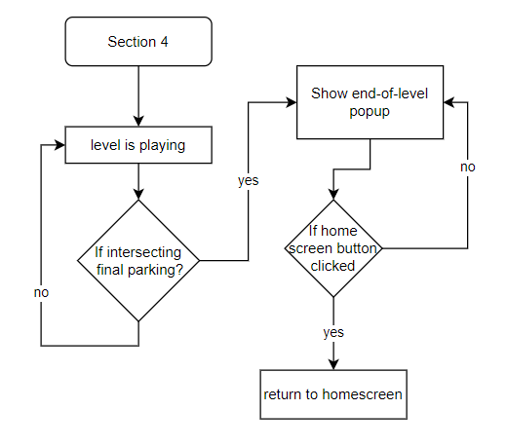
Section 4
My 4th section will focus on how the gameplay stops when the player finishes a level. When the player reaches the desired parking space, the car level will end, and the level ending pop-up will be brought up allowing the player to return to the main home screen and play other levels or access customizability options.
End of level pop-up design
Flowchart

Slide 41
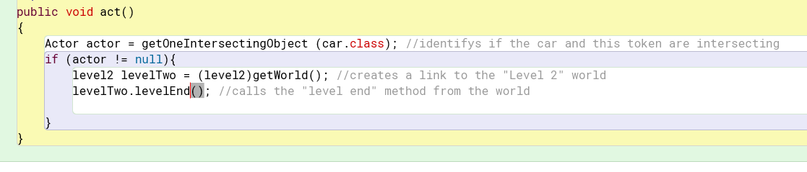
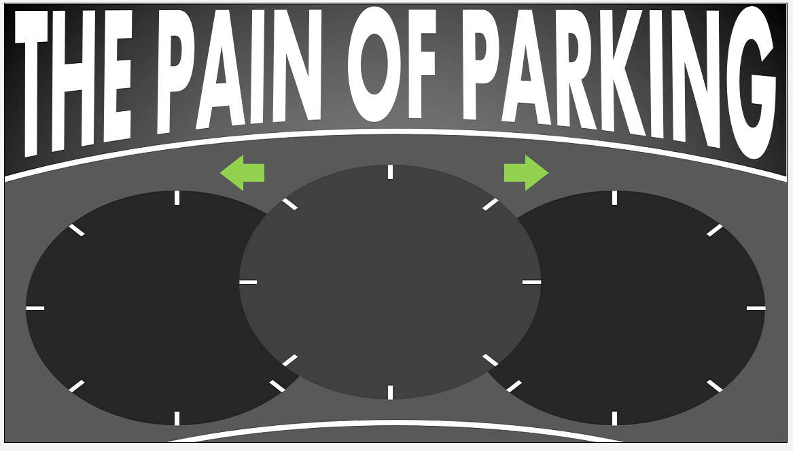
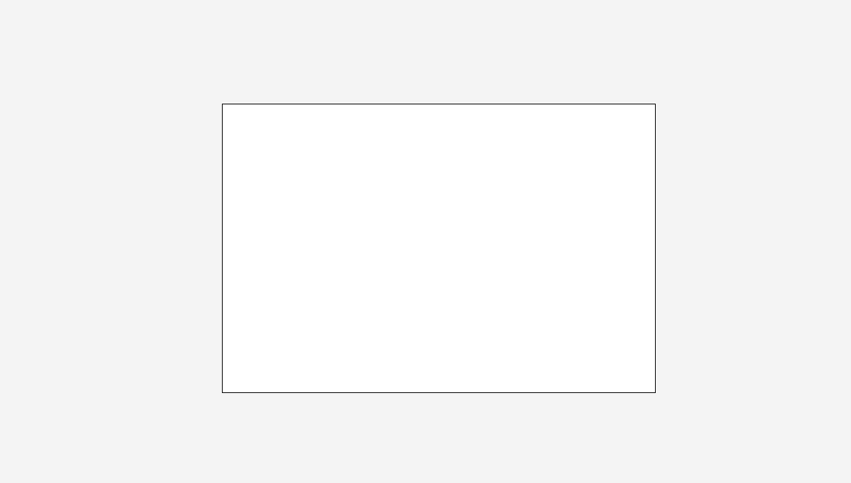
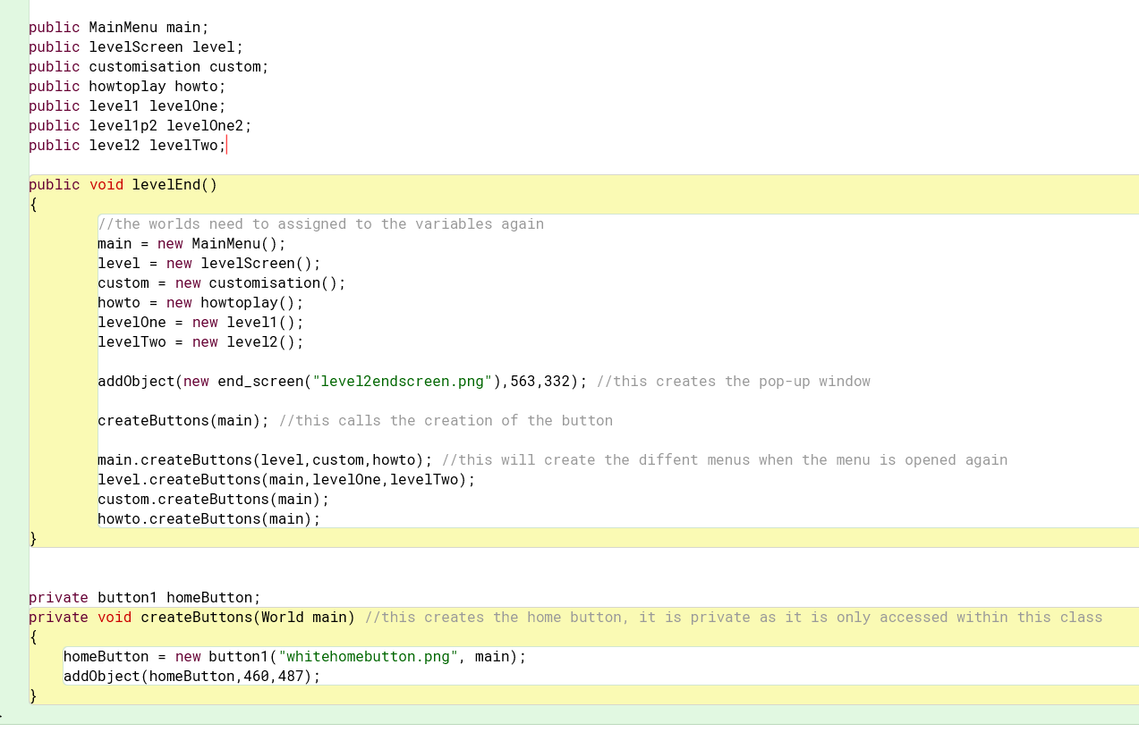
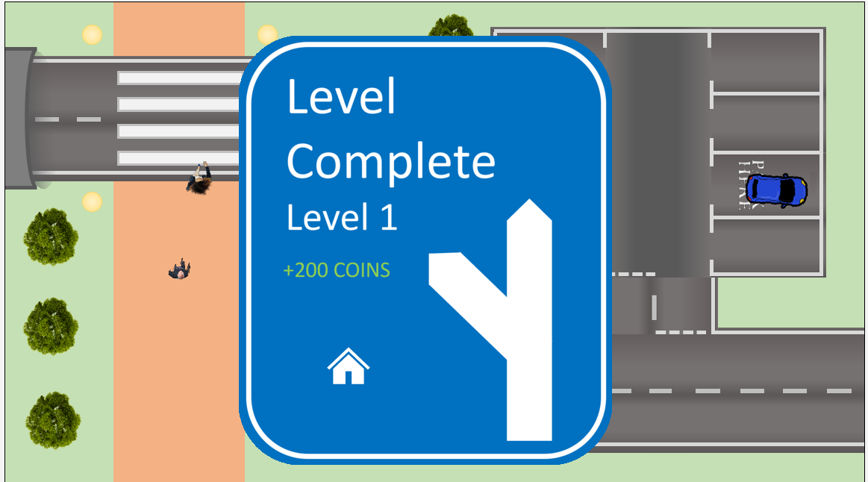
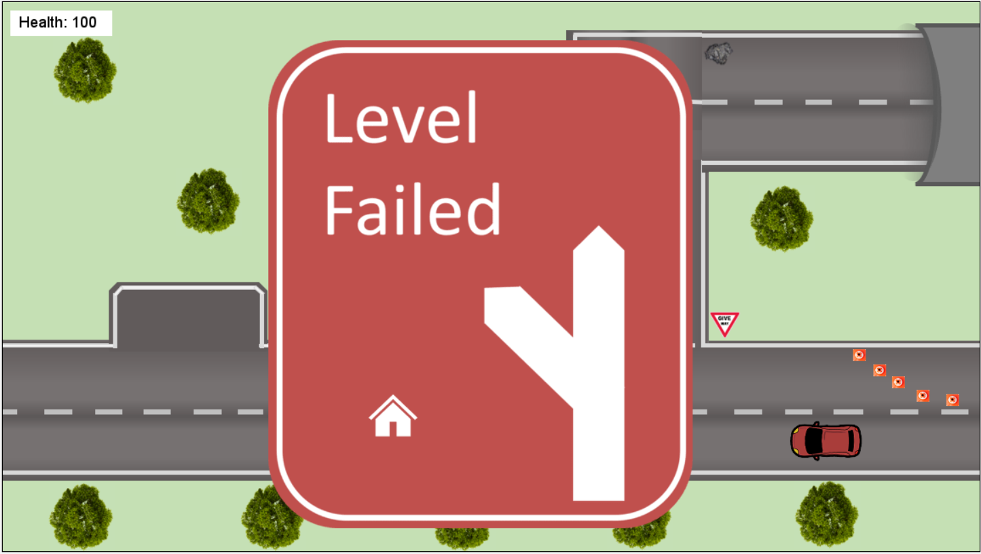
Section 4
Problem #1 – Home Button at end screen
As the level end pop-up and home button had to be created in the world, it was very challenging to figure out a way for it to correctly link the home button to the actual main menu. It would either create the MainMenu() world screen without the buttons or create the completely blank start() world ( both pictured below).
To get around this problem, I instead checked if intersecting within the "token" object class. I then linked it to the level world to create not only the end pop-up but also the home button. I later added a similar feature for implementing the “level failed” screen which opens the level failed screen when the health reaches 0 (see section 5 problem #2 and #5)
However, this did require me to need to re-create and reassign the variables to create the various buttons needed in each menu screen for the menus to work as intended. Furthermore, I used a private method inside of the class to create the buttons rather than using creating the buttons for the world inside the start() class as the others were created. The final code is pictured to the right and the final designs below.

Slide 42
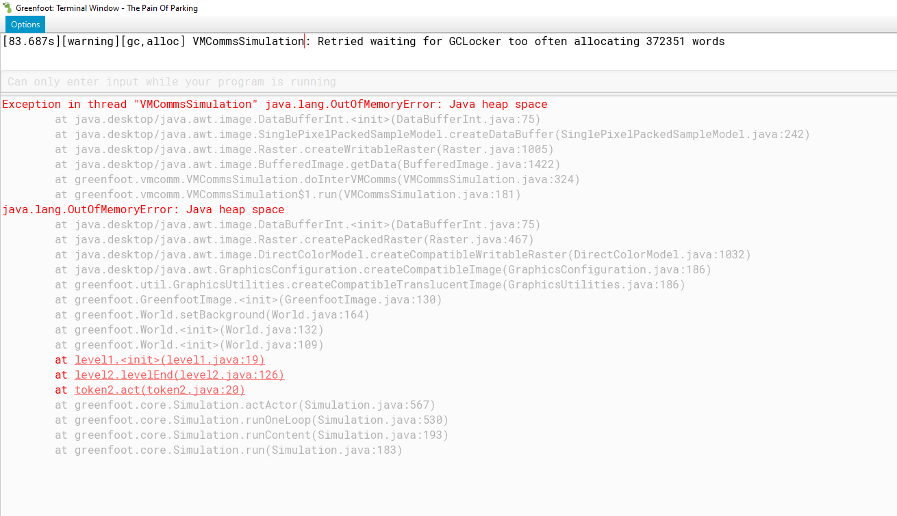
Section 4
Problem #2 – Out of Memory
After test running the games a couple times, I came to the discovery that Greenfoot flags up an out of memory error when finalising the level. After doing some googling, it seemed this was simply because there were too many objects instantiated in the run of the game for Greenfoot to handle. Once the error does come up, the only option is to completely close and re-open the program.
However, after testing, I found that it only happened after the levels were run at least 8 times each. Although this may shorten after I add my subsequent sections, it seems that this problem can be avoided if not run too many times. In the future, using a program with more capability than Greenfoot would have made this problem less likely.

Slide 43
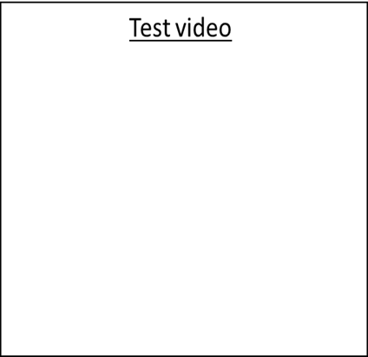
Section 4 – Test Plan
4 | No. | Description | Test Data | Expected Output | Actual Output
 | 1 | Do the end-of-level screens open when intended to? | Car reaches destination | The end-of-level screen opens when the Car finishes the level successfully to reward the player. | The end screens open once the car intersects with my "token" that sits in the parking spaces.
 | 2 | Do the end-of-level screens link back to the Main menu. | Home button pressed on end-of-level screen | The Main menu is opened when the level finishes after the player presses home. | The end of level screens do link successfully back into the main menu which keep their functioning buttons. However, there is a memory issue when the menu button is used too much.
https://youtu.be/TAn3iMVMg1o
End of Stage review = -This stage of my game took about as long as I had expected as I was already unsure how the worlds would link based off my struggle with them in section 1. However, after resolving the difficulty with the buttons , the section was reasonably short and still does work as intended. I am still cautious of the memory error as it may limit how the game can be played going forwards in my forthcoming sections.
Success = 7/10

Slide 44
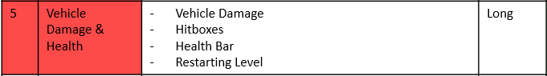
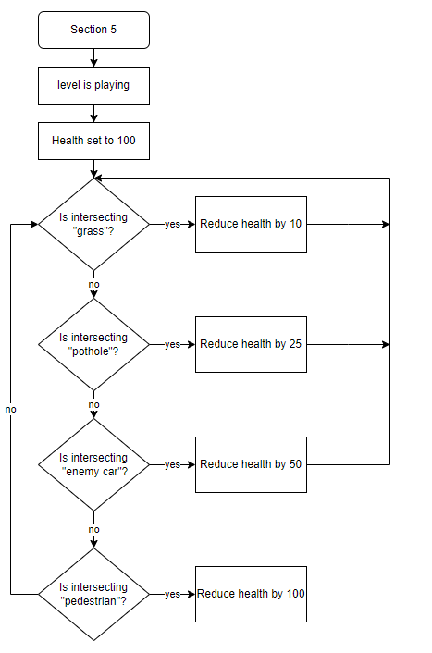

Section 5
In the 5th section, I will develop the vehicle damage options for the car. This will mean that health will have to be made and the vehicles will be damaged to different amounts based on what they are interacting with. I will try to make the hitbox for the car into a circle to make it less sensitive when turning/colliding with certain objects. I will also create a health bar for to visualize the health to the user and make sure that the level is restarted once the health reaches 0.
Flowchart of health reduction logic
Hitboxes = after some research, I have found several ways of identifying hitboxes included in the actor class (website: Greenfoot | Hitbox Visualizer)
Circular Hitbox =
getObjectsInRange(range,null)
Rectangular Hitbox =
getIntersectingObjects(null)
Combined Hitboxes (Green Section) =
getIntersectingObjects(null) AND
getObjectsInRange(range,null)

Slide 45





Section 5
Problem #1 – Actor interaction with obstacles
I encountered a problem when trying to use the regular getIntersectingObjects() method in Greenfoot that it would often become too sensitive due to the corners of the image I used as my main actor. After some research, I found that the union of the original getIntersectingObjects() and getObjectsInRange() gets less of the corners of my image (as shown with diagrams on slide before). The code is written to show how each hitbox is managed.
After experimenting with this, I found varying degrees of success, and the car was still sensitive when at an angle. I have concluded that it is a limit to Greenfoot as a coding platform. If I were to have more time, a platform such as Unity would have allowed more freedom of hitboxes.
Above shows how there remains problems with the hitbox at an angle as it interacts with the grass/car.
However, these bottom examples seem relatively functional for more accurate hitboxes.
In this version, the game just stops once interacting with an obstacle.

Slide 46




Section 5
Problem #2 – Reducing health
Reducing health is very sensitive when I first implemented it. As the health would continue endlessly. To fix this problem, I reduced the amount of health lost when hitting different obstacles (such as enemy car to -25, pedestrian to -40 and pothole to -1). I also made it so that the moving actors were deleted once they were hit so that only the correct amount of health is lost with each interaction.
Problem #3 – Health Box
When generating the health box, I had trouble trying to create the right sizes text box. In my first attempts, the font would extend beyond the box and upon removing the empty white space, would completely change the position of the box.
I solved this problem by changing the fillRect rather than the size of the image as it seemed to remain the size I wanted whilst also remaining in the corner. It also meant I did not have to sacrifice a smaller font size.
Final working example (-15 health from hitting moving car)
Attempt 1
I also had to implement individual connected worlds for each of the interacting obstacles in order to open up the appropriate “level failed” menu and return to the main menu screen. As most are on their own individual “world”, connecting them to their target world when opening the ending menu was simpler. However, the grass, which is shared across all levels, was more difficult to pinpoint (problem 5).
Final

Slide 47



Section 5
Problem #4 – Health on the grass
Each other enemy obstacle is on a specific level (e.g the cones are only on the Level 1 part one) however, the grass is on each level. This means, for my method to work and restart the level, it does not link to the necessary world.
To solve this problem, I researched how to check if my actor was in the right world. The Greenfoot forum (https://www.greenfoot.org/topics/2308) showed me an easy method using “this.getworld().getclass()” and comparing it to my desired world for each class. This makes sure that the ending screen for my intended class can call the level End screen – avoiding the error message.
The final code is pictured below.
When interacting with the grass
When interacting with enemy_car

Slide 48







Section 5
Problem #5 – Health Bar re-gen
After moving to the 2nd part of level 1, the health bar is reset to 100. In order for the health to be kept across levels, I used inheritance by moving the levels worlds into a "Levels" subclass (pictured to right).
This meant that my health could now be kept across into the 2nd world as health was now stored across the worlds. I created the static healthUpdate and getHealth methods which can be called from throughout the program to change and receive the health value. I then set it begin from 100 when first starting on Level 1 and 2.
I came across a problem when the car interacted with enemies that had multiple instances close together (such as the cones or grass) as the game would continue to reduce health after the "level failed" screen appeared due to the vehicle still interacting with the enemy. This would cause the health already be slightly reduced once the level is opened again. To prevent this, I added an element where the players car will be removed once the health is empty to avoid further health being lost. This is shown on the bottom picture.
However, there remain some occurances where the enemy vehicles do not reduce any health despite no difference to the code. I believe this is a limitation of using the Greenfoot software compared to a larger game creation program.
Health is reset after entering 2nd part of Level 1
Health is preserved across levels.
New methods are created into Levels subclass
Instead of changing health, the healthUpdate method is called and the getHealth value is reduced by the desired value.
The health was already reduced after previously reaching 0 health by interacting with the grass.
The enemy is removed from the world once health has reached 0

Slide 49
Test Plan – section 5
5 | No. | Description | Test Data | Expected Output | Actual Output
 | 1 | Car loses health when damaged | When interacting with obstacles | The health bar reduces at different increments when the car hits pedestrians, curbs, cars or potholes. | The car health reduces when interacting with objects. However, due to the sensitivity, I reduced the amount it changed by.
 | 2 | Car only loses health when fully interacting with obstacles | When interacting with obstacles | Health should not be lost when the car does not fully hit an obstacle. | The car mostly has a smaller hitbox other than when at an angle.
 | 3 | Health bar reduces | When interacting with obstacle | Bar reduces visually | The Number in the health bar reduces when the car health reduces.
 | 4 | Game restarted when health = 0 | When interacting with obstacle | The car will be returned to the start of the level and health is full when health reaches 0. | A "level failed" screen appears when health = 0 and it returns to the main screen on all 3 levels.
https://youtu.be/CBYRWpqxGlc
End of Stage review = -This stage of my game took longer than expected as there were many problems when implementing the health box visually to making the health change and remain the same through different worlds. However, although it has gone further than I had planned, they all work as intended now and the gameplay finally feels fully functional. There remain some problems that there is still some lag and sometimes that the health is not reduced which I would assume would be down to the high memory required and the usability limitations of Greenfoot as a program.
Success = 6/10

Slide 50



Section 7
I began with the 7th section before the 6th as it seemed a more interesting and simpler feature to add to my game – changing the appearance of my car. In this section, I aim to be able to select different car colours and then use them in throughout the game in both levels.
Car
+ STR image
+ setCar()
+setEquipped()
Car – New methods in the car class will include setting the image and changing the image based on whether its equipped or not.
Interface – as I am skipping out section 6, I have changed my idea for the customisation screen design to feature no currency. I Could always add the currency back into the game if I had time.

Slide 51






Section 7
Problem #1 – Equipping the car
I came across a problem when trying to equip the new car across worlds. The get and set methods were not functioning as intended as they weren’t passing the correct values into the static methods. I solved this by removing a repeated setImage() that was in the act() method in the car class which was endlessly setting the car to blue. To solve this, I used the system print statements to see what was passing into my setCar() method before finding the problem – this is shown below as the previous print used to continuously print “blue_car.png”.
This is the code in Levels class that sets and gets the Car.
The car is continuously printed a “blue_car.png”
This is in the worlds and sets the cars to the setImage.
Functioning car customisation
The working code allows for different cars to change.
Problem: The car only equips after two times of running the level. The player must crash first and open the level up again for the new customisation to load. I have assumed this is a limitation of Greenfoot as a coding environment.

Slide 52






Section 7
Problem #2 – How to tell if selected?
I then encountered the problem with selecting cars to be played as when the other cars could not be visually unequipped and reset to full opacity (although they could still be equipped). When trying to add another method to try to make them no longer transparent, it came with a syntax error that it cannot reference it from a static context. I solved this problem by creating a private, static attribute called equipped in each car icon class. This could then be equipped and unequipped using separate static methods. There is also a method always running in the act() of the equippable cars that change the opacity to full (unquipped) or to half (equipped).
To reset the other cars back to full opacity when another car is equipped, I needed to call the reset__Equipped() from each class when clicked. This would reset the cars back to being unequipped.
When the game is first opened, I used the start() class to reset the different icons to be equipped when the game is first run. The blue car icon is set to equipped as it automatically used when the game loads. All other car icons are set to unequipped. This is shown below.
This is my first attempt to reset the car icons to transparent that did not work due to not being static.
This is how the car looks when unequipped (right) and equipped (left).
This is my final code with the static attributes and methods to update the transparency of the car icons.
This is an example in the Purple car icon class that will turn the purple icon to equipped and all others to unequipped.

Slide 53
Test Plan – section 7
7 | No. | Description | Test Data | Expected Output | Actual Output
 | 1 | New cars can be equipped | Unlocked car is clicked on | The car will be selected onto the preview on the left. | Car is equipped when clicked on after the game is reopened for the 2nd time.
 | 2 | Cars equipped are now playable in the levels | Unlocked car is equipped | The playable car will have the new customisation for the gameplay. | The car will load after 2 levels.
 | 3 | Car can be unequipped if clicked on | The car is clicked on | The playable car will return to the basic blue car and the car will once again say "equip" | This is not working visually but other cars can set without visually seeming equipped.
Test Video
https://youtu.be/6A0iI3_O4O4
End of Stage review = - I found this section a lot harder than I expected it to be and it took a lot longer. The code for my car equipping for in game worked similarly to the health by being changed in the level Class. However, due to restrictions of Greenfoot, it seems that the car doesn’t equip exactly as I would like. Also, the visual graphics that display equipping do not work which I also assume as a problem with Greenfoot – this also makes it a problem if I wanted to implement currency from my section 6. If I were to create in a more advanced program such as unity, I expect it would have more usability for these features.
Success = 4/10

Slide 54

Section 8
Continuing with the 8th section, I attempted to add some audio as it was something I enjoyed from the similar games I played. Therefore, I looked for fun background music that could play throughout my game to make it more fun.
Pseudocode to turn on/off sound:
- Call method in start class to create sound if button is pressed?
(in start class)
PROCEDURE void playMusic()
play musicfile
END PROCEDURE
(in muteButton class, if button pressed)
IF muteButton == down THEN
stop musicfile
ELSE
playMusic();
END IF
Mute Button – The button will be needed to turn the music off. Having it off will allow the music to play in another class.
Audio – The audio File I found to use was this: Game background Music loop. As it was a fun and joyful background music.

Slide 55





Section 8
Problem #1 – Getting the background music to loop
After some research, I found the Greenfoot.playSound command to play music, however, this only plays the music once before stopping. I put it in the Start world so that it will play when the game is opened.
After some more googling, I found the playLoop method which requires the greenfoot sound to be created at the top of the class. This then allowed for the music to keep getting looped after played.
In the class:
In the constructor for the start world:
Problem #2 – The Mute Button
I came across a problem when trying to implement music that means that the loops never stops even after the game has ended. This made a mute button even more important. I changed my idea for the mute button code to allow visual changes as well as well as better functionality.
In the start menu, a static subroutine will play and stop the music.
This IF statement sets the right image of the button when music is playing or not.
This sets the music to play when the level is started. But simply clicking on the mute button icon will stop/play the music to the players will.
In the mute button class, a simple if statement will change the icon and play the music depending on whether music is played or not.
<< The icons I used for soundOn and soundOff

Slide 56
Test Plan – section 8
8 | No. | Description | Test Data | Expected Output | Actual Output
 | 1 | Background music plays when the game is played | Game is run | The background music is played | Yes, the background music is played throughout the game without overlapping.
 | 2 | The background is muted for all levels if the "mute" button is clicked | Mute button clicked | Background music is turned off entirely if the "mute" button is pressed. | Yes, the background is muted for all levels once pressed.
 | 3 | The car will make sounds when player presses buttons | Player presses keys | The car has sound-effects such as engine sounds, indication or car horns. | I could potentially implement this in the future, if I had more time.
Test Video
https://youtu.be/5oxYsix0AtI
End of Stage review =
The background music was a lot simpler to implement, and the mute button did not cause as many problems as I had thought. The background music proved to be an easily-implemented and successful addition that added more fun to the game. Perhaps, if I had more time, I could implement engine sounds and other audio aspects to make the game even more realistic.
Success = 8/10

Slide 57
Section 6 & 9
7 | No. | Description | Test Data | Expected Output | Actual Output
 | 1 | Currency set to 100 when game opens | Program is run | The currency will be set to 100 when the game opens for each player
 | 2 | Cars can be purchased | Car unlockable is clicked on | The car will be bought if the player has the right amount of currency.
 | 3 | Currency decreases and increases in the menu | Currency is lost or gained | The player's currency balance changes depending on how they spend or play.
 | 4 | Car icon set to be equipped. | When the car is bought | The car will now say "equip" rather than "buy". The newly bought car can now be equipped by clicking on it.
I skipped out section 7 as this would have taken too long to implement in my time scale. I instead focused on fixing how the car customisations could be equipped. If I could spend more time on this project, I would have implemented better.
9 | No. | Description | Test Data | Expected Output | Actual Output
 | 1 | The main menu opens when the game is entered. | Car finishes level | The main screen will open when the player finishes level.
 | 2 | The game can be played | Play button is pressed | The game opens up its gameplay screen.
 | 3 | The playing piece is moved by arrow keys | Arrow keys pressed | The play pieces is moved left and right to avoid attacks from falling obstacles.
 | 4 | The game will give the player more money reward | Gameplay is finished | The player earns more currency from completing the game.
My section 9 was already an aspiration only if I had completed the game earlier. However, due to the large amount of time it would take to implement, I also missed this section out as it would have required me to make an entirely new game. However, if I had time, it would be stage I would complete if I were to change my game.

Slide 58
Post-development testing
For a final part of testing, I will alpha and beta test it to test its robustness and functionality. As a final run through, I will test the robustness myself by using different tests to make sure my game cannot be easily broken.
No. | Robustness Test | Test Data | Expected Output | Actual Output
1 | Will my game run on different spec. computers? Which types? | Run on different computers. | The game will run smoothly. | Although there are a couple of glitches with changing car customisations and taking damage, the game runs mostly smoothly.
2 | What will happen when the keyboard is smashed? | Smash the keyboard whilst the game is running | The game will not crash or glitch. | The game does not crash or glitch. It simply does not react.
3 | What happens if the WASD keys are used rather than the arrow keys? | WASD keys used | The car will not move. | The car does not move. This works as intended. Perhaps I could implement using the WASD and arrow keys interchangeably.
Final Test Video
https://youtu.be/_vh3s5wOIRc
After testing it myself, I will ask a group of testers to beta test my code. I will use the following questions to understand if my game is aesthetically pleasing and easy to use. I made this form: My Questions:
- Was the game’s appearance attractive?
- Were there any glitches you came across? What were they?
- Did you enjoy the customisability options? Are there any different options you would like to add?
- Were the controls easy to understand?
- Were icons easily recognisable and easy to use?
- Was the background music enjoyable?
- Were the game obstacles adequately difficult to manoeuvre around?
- Was the map easy to navigate around?

Slide 59
Beta Testing

Slide 60



Beta testing – Problems/glitches
From my feedback, It seemed that most people experienced 1-2 glitches. This is good as most of the glitches experienced were glitches that I know of from my own testing rather than any newer problems. The most prominent problems encountered were memory errors, health errors on potholes or cars and the problem of not changing the car customisation quick enough. Although I have assumed that the memory error is due to the limitation of Greenfoot, it is the easiest problem to fix by simply re-opening Greenfoot. However, it is still frustrating for users to re-open the environment repeatedly. The pothole/car error is something that I must spend more time on to attempt to fix the problem as it seems most likely to be a logic error.
From my feedback, I had a range of computer specifications. It seemed that most people encountered similar problems regardless of the machine they were using. Perhaps, in the future, I could test a wider range of different specifications (e.g. laptops) to gain a greater understanding of the optimal specifications to play the game. The memory problem seemed to occur regardless of the machine – this may have been a restriction with using Greenfoot rather than the computer downloaded on.

Slide 61





Beta testing – Menu and Music
From feedback, it seems that most people enjoyed the appearance of the menu screen. However, perhaps I can make it a bit more realistic if I were to remake the game. I could also make the indicator buttons either part of the menu screen or look more like the realistic car dashboard as many got confused over why there were there.
From feedback, people thought that the play buttons were mostly easily recognisable when navigating the menu screen. Perhaps I could make them more obviously buttons in future edits of my game.
I also understood from feedback that the how-to screen was useful in showing the controls of the game. From my own reviewing of the beta tests, I think that it may be perhaps useful to outline that the how-to screen is viewed before the first level is played. This is because many of my play-testers skipped this stage.
The feedback also told me that people enjoyed the music that I chose to accompany the game.

Slide 62




Beta testing – Customisability and Level appearance
From feedback, it seemed that there were various ideas for customisability options. Although there was mainly good feedback for the pre-existing customisations, there were many responses to add a wider range of cars and colours as well as currency to purchase new cars. This was going to be added in my original idea if I had more time and was definitely a good idea to add in the future.
Overall, there was still a positive review of the level’s appearance. However, there was also added input to include more detailed and realistic grass and obstacles. This could be something to add in future updates.
The realism of the project may somewhat go against my more childish aspect of the game; however, the game already seems too difficult to manoeuvre for children as shown by statistics on manoeuvrability.

Slide 63


Beta Testing – navigation and manoeuvrability
From the responses, it seems there was a varied understanding of how to navigate the map. Although I added some elements to try to direct the user into the correct path (e.g. the safety cones), in retrospect I should perhaps have added an arrow to help show the correct direction. This is backed up by the responses.
I also gained mixed reactions for the manoeuvrability of the car. Even with the how-to page, it seemed that the turning system confused many of my beta testers. Perhaps I could change the driving system to something easier to use in the future – such as a steering wheel design or constant accelerations.

Slide 64


Beta Testing – additions and bug fixes
From feedback, it seems that the responses wanted a range of additions and bug fixing features. Some people did like the idea of adding my pre-existing ideas of currency options to purchase new cars and mini games. These would have been implemented if I had more time. Otherwise, the additions of more levels would also have been implemented with more time. The bug fixing issues should be investigated as I feel that some of the elements of navigation and health bar were issues with some users.

Slide 65
Evaluation

Slide 66
Evaluating against Criteria – Menu & Sound
Feature | How far met? | Comments | Evidence
Game Title (Criterion 1a) | 8/10 – Met | The screen opens successfully when the game is run using my design plan (see development 1, plan). It is made using a design of a car dashboard and the title is in bold. From the results of the beta testing, it seemed that many of my testers liked the design. There were some requests to add more colour and remove the confusing indicator arrows (see beta testing, menu). If I were to remake the game, I perhaps would have opted for a more detailed screen to more easily be recognised as a car dashboard and avoid these problems. | Development: Section 1 development Evaluation: Beta Testing - menu and sound
Options buttons (Criterion 1b) | 10/10 - Met | The options buttons correctly take you to different pages and back to the home screen. Although it took longer to implement then I had initially expected (see development 1, problem 1), it works well thanks to tutorials, and it makes the game more seamless. From the beta-testing, it seemed that the testers found the icons mostly easy to recognise to start the game. | Development: Section 1 development Evaluation: Beta Testing - menu and sound
Sound (Criteria 1c, 5a) | 9/10 - Met | The sound settings were easy to add and added a nice, more childish feeling to the game. Overall, it received reasonably good response from my testers (see beta testing, sound). Furthermore, my persistence with adding a mute button became useful for those who did not like the music. Therefore, I think this section was wholly successful. | Development: Section 1 development Evaluation: Beta Testing - menu and sound
How to play menu (Criterion 1d) | 8/10 – Met | The how to play menu was easy to implement as it was simply another world with a picture. From my own testing as well as my beta testers (see evaluation, sound), it seemed that the how to play menu could be slightly more obvious before playing as it seemed the instructions were easy to miss. However, the instructions were ultimately useful in showing the player how to control the car (see beta testing, menu). | Development: Section 1 development Evaluation: Beta Testing - menu and sound

Slide 67
Evaluating against Criteria - Gameplay
Feature | How far met? | Comments | Evidence
Car movement (Criterion 2a) | 9/10- met | I expected the car movement aspect to be a quick section of my project as it was relatively quick part to code. Although I did encounter some problems with the controls in the development (see development 2, problem 1), it was ultimately easy to implement and therefore I met it easily. | Development: Section 2 development - problem 1 Evaluation: Beta Testing - navigation and manoeuvrability
Turning (Criterion 2b) | 6/10 – partially met | This element of my game was also easy to implement. I found it more difficult to make the steering functional as I wanted to (see development 2, problem 1) but it was quick to fix. Some evaluation feedback reported that the car was still difficult to manoeuvre around the map (see beta testing, manoeuvrability) which is something I would look into to try to make the driving smoother for users. I could in the future, use different keys for acceleration and steering to allow for the car to be driven easier. | Development: Section 2 development - problem 1 Evaluation: Beta Testing - navigation and manoeuvrability
Parking (Criterion 2d) | 7/10 – partially met | The parking element of the game was one of the core features I needed to implement for users to finish each level. I decided to do this by using an almost invisible block that players must interact with to finish the level (see development 4, flowchart). This created the problem that many users parked into the spot and did not go far enough in the space to interact with the “end level” token. Furthermore, the car did not need to be parked very well for the menu to come saying the level was finished. These were highlighted by my own testing as well as verbal feedback from testers. If I were to look more in depth in this factor, I would definitely change how the parking is managed to make it more realistic to complete. | Development: Section 4 development Evaluation: Beta Testing - navigation and manoeuvrability , Finding the final parking area problem

Slide 68
Evaluating against Criteria - Gameplay
Feature | How far met? | Comments | Evidence
Health (Criterion 2c) | 7/10 – somewhat met | This section of my coding was more difficult than I had expected, as I had to use inheritance to change my health on the health board to preserve it between the two screens for level one (see development 5, problem 5). This seemed to change the ability for the health to be changed easily in the second level, where interacting with the enemy car often did not reduce health. This was brought up often among my beta testers on glitches and problems with the game (see beta testing, glitches/problems). From my own testing, it seemed that this was very much an area which was very temperamental as to when it worked, and it would require more time to figure out the logical error. Otherwise, the health decreases well when colliding with other enemies. Therefore, I have labelled it as partially met. | Development: Section 5 development Evaluation: Beta Testing - glitches
Mini Games (Criterion 2e) | 0/10 – not met | This section was included as a potential limitation during my criteria list. Unfortunately, I did not get to implementing this feature (see development 9). From my beta testing stage, there were two of my beta testers who were interested in the potential additions of mini games (see beta testing, additions). Although this criterion was not met, I do think it would be an interesting feature to add in the future. | Development: Section 9 development plan Evaluation: Beta Testing - additions
Timings (Criterion 2f) | 0/10 – not met | As I progressed through the game, this potential feature became increasingly unlikely to be implemented as it would require a complete remodel of the game idea I had. Although it would have made the game more involved in gaining rewards, it is something I have disregarded adding into my game. Furthermore, since I never ended up implementing currency, it did not seem to be the most important feature to add. | Development: -- Evaluation: --

Slide 69
Evaluating against Criteria - World
Feature | How far met? | Comments | Evidence
Level Map (Criterion 3a) | 7/10 – partially met | I had initially expected the level maps to take a while to create due to my previous experience with Greenfoot. These problems were highlighted in my development stage (see development 3, problem 1) where the road was shuffled around every time that I would save the world. Other than this I encountered some other problems when making level 1 have 2 parts in developing the boundary movement (see development 3, problem 4). Although this made the world creation take a while, it was ultimately successful in creating the overall look of the levels. From my beta testing, I received feedback for potential additions for directing the player where to drive to. Adding an arrow or map feature would have improved the navigation of the game, which in beta testing only received lower score. This seemed like a problem for a couple users so I would like to investigate this if I were to remake the game in the future. However, due to generally positive feedback of the appearance of the game (see beta testing, level appearance), I have put this section as partially met. To further improve, perhaps I could add more detailed grass, as mentioned in responses to the level appearance (see beta testing, navigation). | Development: Section 3 development Evaluation: Beta Testing - level appearance, Beta Testing – additions, Beta Testing - navigation and obstacles
Obstacles and enemies (Criterion 3b) | 6/10 – partially met | The obstacles and enemies were limited due to only having 2 levels, however, the obstacles that were implemented work to varying degrees of success. A common problem in the glitches experienced was the pothole and parked cars causing the game to crash (see beta testing, problems/glitches). I experienced this problem myself when testing the game and it seems it occurs from the player staying on the pothole/car after health has already become 0. Similar problems happened with the other obstacles where I simply made them to delete themselves from the Greenfoot world when interacting – however, I dislike this approach as it feels very unrealistic. This problem could be further fixed with a deeper look for the potential logic errors. I also experienced many problems trying to reduce health when on the grass (look development 5, problem 4) which took up a lot of time to fix. Many of my beta testers that expected more enemies and obstacles were also those who asked for more levels; this would be focused on in the full game. Obstacles and enemies such as pedestrians worked well (see development 3, problem 3). Therefore, I have put this criterion as partially met. | Development: Section 3 development, Section 5 development Evaluation: Beta Testing - problems/glitches, Beta Testing - navigation and manoeuvrability

Slide 70
Evaluating against Criteria – World 2
Feature | How far met? | Comments | Evidence
Level Difficulties (Criterion 3c) | 8/10 – met | When creating the levels, I hoped they would be of differing difficulties to allow the user a wider look on my game without making many levels. Although I did get some feedback to make more levels (see beta testing, additions), there was a large difference in the 2 level’s difficulty. Although some users thought that the second level is more difficult than the 1st, which can easily be solved by switching them around. Therefore, I have labelled this criterion as met. | Development: Section 1 development - level plans Evaluation: Beta Testing - navigation and obstacles, Beta Testing – additions
End of Level screens (Criterion 3d) | 10/10 - met | The end of levels screen work well and open when opened. Despite taking some time to implement (see development 4, problem 1), they work efficiently. Therefore, I have met with this criterion. | Development: Section 4 development Evaluation: Beta Testing - additions

Slide 71
Evaluating against Criteria – Customisation
Feature | How far met? | Comments | Evidence
Car colours and Types (Criterion 4a) | 5/10 – partially met | I had varying degrees of success with the customisation part of my game. The choices were rather limited, as shown by the many suggestions by beta testers (see beta testing, customisation responses). In the future, I would add a wider variety of cars and colours to drive. There was also a consistent problem where the car customisation would not update until the car had crashed once more on the level. This was mentioned by testers (see beta testing, problems/glitches). This aspect would take a long time to locate the logical error for the car to update instantly. The customisation section took me a lot longer to code than I had anticipated due to problems with selection (see development 7, problem 2). However, I ultimately got this working well, so I have labelled this criterion as partially met. | Development: Section 7 development Evaluation: Beta Testing – customisation, Beta Testing - problems/glitches
In game currency (Criterion 4b) | 0/10 – not met | The large problem I had with equipping customisations left little time to implement the in-game currency. Although this feature is something I wanted to add, it would have taken too long to implement a whole currency and reward system in my time frame. From feedback, I have learnt that this was a main improvement users wanted (see beta testing, additions). This would be the first addition to add to the game in the future. | Development: Section 6 development plan Evaluation: Beta Testing - additions

Slide 72
The End

Slide 73
Levels parent Class
import greenfoot.*; // (World, Actor, GreenfootImage, Greenfoot and MouseInfo)
public class Levels extends World
{
private static String setCar = "blue_car.png"; //sets car to blue
private static int health = 100; //sets health to 100
public Levels()
{
super(1151, 647, 1);
}
public static void healthUpdate(int healthV){ //setter of health
health = healthV;
}
public static int getHealth(){ //getter of health
return health;
}
public static void carUpdate(String setCar2){ //setter of car type
setCar = setCar2;
}
public static String getCar(){ //getter of car type
return setCar;
}
}

Slide 74
import greenfoot.*; // (World, Actor, GreenfootImage, Greenfoot and MouseInfo)
public class level1 extends Levels
{
public statusboard lvl1statusboard;
public level1()
{
prepare();
Levels.healthUpdate(100); //sets the health to 100 at the start of a new level
}
/**
* Prepare the world for the start of the program.
* That is: create the initial objects and add them to the world.
*/
private void prepare()
{
road road = new road("roadpark.png");
addObject(road,277,445);
road road3 = new road("road.png");
addObject(road3,657,482);
[etc]
}
public MainMenu main;
public levelScreen level;
public customisation custom;
public howtoplay howto;
public level1 levelOne;
public level1p2 levelOne2;
public level2 levelTwo;
public void levelEnd(int choice)
{
//the worlds need to assigned to the variables again
main = new MainMenu();
level = new levelScreen();
custom = new customisation();
howto = new howtoplay();
levelOne = new level1();
levelTwo = new level2();
if (choice == 1)
{
addObject(new end_screen("level1endscreen (2).png"),563,332); //this creates the pop-up window
} else if (choice == 2)
{
addObject(new end_screen("levelfailedendscreen.png"),563,332);
Levels.healthUpdate(100);
}
createButtons(main); //this calls the creation of the button
main.createButtons(level,custom,howto); //this will create the diffent menus when the menu is opened again
level.createButtons(main,levelOne,levelTwo);
custom.createButtons(main);
howto.createButtons(main);
}
private button1 homeButton;
private void createButtons(World main) //this creates the home button, it is private as it is only accessed within this class
{
homeButton = new button1("whitehomebutton.png", main);
addObject(homeButton,460,487);
}
Level 1 class
(similar for level 1 part 2 and level 2)

Slide 75
import greenfoot.*; // (World, Actor, GreenfootImage, Greenfoot and MouseInfo)
public class start extends World
{
public MainMenu main; //creates main and level variables. Set to public so that it can be accessed throughout program in different worlds.
public levelScreen level;
public customisation custom;
public howtoplay howto;
public level1 levelOne;
public level1p2 levelOne2;
public level2 levelTwo;
static GreenfootSound music = new GreenfootSound("background_music.wav");
public start()
{
// Create a new world with 600x400 cells with a cell size of 1x1 pixels.
super(600, 400, 1);
main = new MainMenu(); //sets global variable to open the Main menu
level = new levelScreen(); //sets global variable to open the level screen
custom = new customisation();
howto = new howtoplay();
levelOne = new level1();
levelOne2 = new level1p2();
levelTwo = new level2();
main.createButtons(level,custom,howto); //sets up the buttons in each class. Calls the public method "createbuttons" from main class.
level.createButtons(main,levelOne,levelTwo); //Calls the public method "createbuttons" from main class.
custom.createButtons(main);
howto.createButtons(main);
start.playMusic(1);
muteButton.setPlaying(1);
//currencyBoard.resetCash();
car_icon_blue.equipBlue();
car_icon_red.resetRedEquipped();
car_icon_cyan.resetCyanEquipped();
car_icon_pink.resetPinkEquipped();
car_icon_purple.resetPurpleEquipped();
Greenfoot.setWorld(main); //automatically opens up the main screen
}
public static void playMusic(int isPlay){
if (isPlay==1){
music.playLoop();
} else if (isPlay==0) {
music.stop();
}
}
}
Start menu class

Slide 76
import greenfoot.*; // (World, Actor, GreenfootImage, Greenfoot and MouseInfo)
public class car_icon_blue extends car_customs
{
//currency changes in this class
private static int equipped;
public car_icon_blue(String image) {
setImage(new GreenfootImage(image));
}
public void act()
{
setCar();
isBlueEquipped();
}
public static void resetBlueEquipped(){
equipped = 1;
}
public static void equipBlue(){
equipped = 0;
}
private void isBlueEquipped(){
if (equipped==1) {
getImage().setTransparency(255); //not transparent
}
if (equipped==0){
getImage().setTransparency(100); //transparent
}
}
public void setCar()
{
if (Greenfoot.mouseClicked(this)){
Levels.carUpdate("blue_car.png");
Greenfoot.playSound("beep.wav");
equipBlue();
car_icon_red.resetRedEquipped();
car_icon_cyan.resetCyanEquipped();
car_icon_pink.resetPinkEquipped();
car_icon_purple.resetPurpleEquipped();
}
}
}
Car_icon_blue class
(similar to other colour icons)

Slide 77
public void hitboxes()
{
Actor actor = getOneIntersectingObject(enemy_car.class);
if ((actor!=null) && (getObjectsInRange(1,enemy_car.class) != null))
{
Levels.healthUpdate(Levels.getHealth()-25);
if (Levels.getHealth() <= 0 )
{
Levels.healthUpdate(0);
level1 levelOne = (level1)getWorld(); //creates a link to the "Level 1 part two" world
levelOne.removeObject(this);
levelOne.levelEnd(2);
}
}
[ETC FOR OTHER OBSTACLES]
Actor actor7 = getOneIntersectingObject(pothole.class);
if ((actor7!=null) && (getObjectsInRange(1,pothole.class) != null))
{
Levels.healthUpdate(Levels.getHealth()-1);
if (Levels.getHealth() <= 0 )
{
Levels.healthUpdate(0);
level1 levelOne = (level1)getWorld(); //creates a link to the "Level 1 part two" world
levelOne.removeObject(this);
levelOne.levelEnd(2);
}
}
Actor actor8 = getOneIntersectingObject(grass.class);
if ((actor8!=null) && (getObjectsInRange(1,grass.class) != null))
{
Levels.healthUpdate(Levels.getHealth()-1);
if (Levels.getHealth() <= 0 )
{
Levels.healthUpdate(0);
if (this.getWorld().getClass() == level1.class) { //checks if in level 1
level1 levelOne = (level1)getWorld();
levelOne.removeObject(this);
levelOne.levelEnd(2);
} else if (this.getWorld().getClass() == level1p2.class) { //checks if in level 1 part b
level1p2 levelOneP2 = (level1p2)getWorld();
levelOneP2.removeObject(this);
levelOneP2.levelEnd(2);
} else if (this.getWorld().getClass() == level2.class) { //checks if in level 2
level2 levelTwo = (level2)getWorld();
levelTwo.removeObject(this);
levelTwo.levelEnd(2);
}
}
}
statusBoard.setValues(Levels.getHealth());
}
}
Car class
import greenfoot.*; // (World, Actor, GreenfootImage, Greenfoot and MouseInfo)
public class car extends gameplay
{
//protected int health = 100;
protected statusboard statusBoard;
public int level1health;
public level1p2 levelOne2;
public car(String image,int choice,statusboard board){
setImage(new GreenfootImage(image));
statusBoard = board;
}
public void act()
{
movement();
hitboxes();
}
private void extendMap(World levelOne2)
{
int xcoord=getX();
int ycoord=getY();
if ((xcoord>=1150) && (50<=ycoord) && (ycoord<=200))
{
levelOne2 = new level1p2();
Greenfoot.setWorld(levelOne2);
}
}
public void movement()
{
if (Greenfoot.isKeyDown("Up") && Greenfoot.isKeyDown("Left")){
turn(-4);
move(3);
} else if (Greenfoot.isKeyDown("Up") && Greenfoot.isKeyDown("Right")){
turn(4);
move(3);
} else if (Greenfoot.isKeyDown("Down") && Greenfoot.isKeyDown("Left")){
turn(4);
move(-2);
} else if (Greenfoot.isKeyDown("Down") && Greenfoot.isKeyDown("Right")){
turn(-4);
move(-2);
} else if (Greenfoot.isKeyDown("Up")){
move(4);
}else if (Greenfoot.isKeyDown("Down")){
move(-2);
}
extendMap(levelOne2);
}

Slide 78
Token 1 class
(for ending the level), similar for token 2
import greenfoot.*; // (World, Actor, GreenfootImage, Greenfoot and MouseInfo)
public class token1 extends gameplay
{
public void act()
{
Actor actor = getOneIntersectingObject (car.class); //identifys if the car and this token are intersecting
if (actor != null){
level1p2 levelOneP2 = (level1p2)getWorld(); //creates a link to the "Level 1 part two" world
levelOneP2.levelEnd(1); //calls the "level end" method from the world
}
}
}

Slide 79
import greenfoot.*; // (World, Actor, GreenfootImage, Greenfoot and MouseInfo)
public class enemy_car extends enemies
{
public enemy_car(String image){
setImage(new GreenfootImage(image));
}
public void act()
{
movement(); //moves the car forwards
regen(); //regenerates this enemy car when reachin the other side of the game
interact(); //deletes car when interacting with the player's car to avoid further damage taken
}
private void movement()
{
move(-4);
}
private void regen()
{
int xcoord=getX();
if (xcoord==0) {
setLocation(1151, 517);
}
}
private void interact()
{
Actor actor4 = getOneIntersectingObject(car.class);
if ((actor4!=null) && (getObjectsInRange(1,car.class) != null))
{
level1 levelOne = (level1)getWorld();
levelOne.removeObject(this);
}
}
}
Enemy_car class

Slide 80
import greenfoot.*; // (World, Actor, GreenfootImage, Greenfoot and MouseInfo)
public class enemywoman extends enemies
{
public void act()
{
setRotation(270);
movement(); //maybe add changing car colours if have time.
regen(); //starts from the beginning when reaching edge of world
interact(); // deletes itself when interacting with car class
delay();
enemyWomanChange();//animates woman to walk
}
private void movement()
{
move(1);
}
private void regen()
{
int yCoord = getY();
if (yCoord==0) {
setLocation(260, 647);
}
}
private void interact()
{
Actor actor4 = getOneIntersectingObject(car.class);
if ((actor4!=null) && (getObjectsInRange(1,car.class) != null))
{
level1p2 levelOneP2 = (level1p2)getWorld();
Greenfoot.playSound("scream3.wav");
levelOneP2.removeObject(this);
}
}
int delay;
private void delay()
{
delay += 3; //delay increases by 3 each time its run
delay %= 120; // delay is MOD by 120 as there are 60 frames per second twice
}
private void enemyWomanChange()
{
if (delay%60 == 0)
{
setImage("womanwalking"+(delay/60+1)+".png");
}
}
}
Enemy_woman class

Slide 81
Button class
public class button1 extends menu
{
private World link;
public button1(String image,World Link){
setImage(new GreenfootImage(image)); //sets the button to this image, passed through constructor.
this.link = Link;
}
public void act()
{
if (Greenfoot.mouseClicked(this)){ //opens the linked world when clicked on
Greenfoot.setWorld(this.link);
Greenfoot.playSound("beep.wav");
}
}
}

Slide 82
import greenfoot.*; // (World, Actor, GreenfootImage, Greenfoot and MouseInfo)
public class statusboard extends Actor
{
protected GreenfootImage background = null;
public statusboard(){
background = new GreenfootImage (120,80);
background.setColor(Color.WHITE);
background.fillRect(0,0,120,30);
//creates the shape of the health box
setImage(background);
}
public void act()
{
//
}
public void setValues(int health)
{
GreenfootImage img = new GreenfootImage (background);
img.setColor(Color.BLACK);
img.setFont (img.getFont ().deriveFont (18f));
img.drawString("Health: "+ health,10,20);
setImage(img);
//change the image of actor
}
}
statusboard class

Slide 83
import greenfoot.*; // (World, Actor, GreenfootImage, Greenfoot and MouseInfo)
public class muteButton extends menu
{
public static int isPlaying = 1;
public muteButton(){
if (isPlaying==1){
setImage(new GreenfootImage("soundOn.png")); //sets image to Sound On when the music is playing
} else if (isPlaying==0){
setImage(new GreenfootImage("SoundOff.png")); //sets image to Sound off when music stopped.
}
}
public void act()
{
if (Greenfoot.mouseClicked(this) && isPlaying==1){
setImage(new GreenfootImage("SoundOff.png")); //sets new image
isPlaying = 0; //sets to 0
start.playMusic(0); //stops playing music
} else if (Greenfoot.mouseClicked(this) && isPlaying==0){
setImage(new GreenfootImage("soundOn.png"));
isPlaying = 1;
start.playMusic(1); //plays music again.
}
}
public static void setPlaying(int choice){
isPlaying = choice;
}
}
Mute button class

